Slide 1
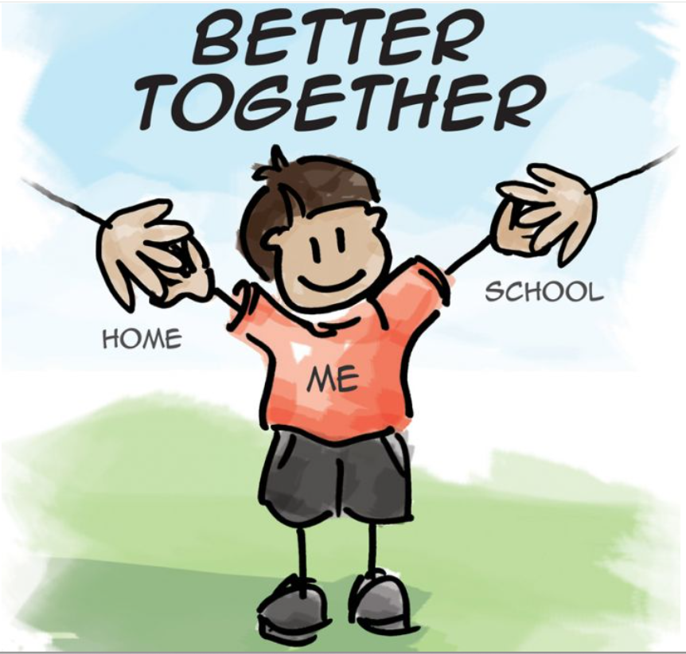
Meet the Teacher
Year 1
September 2026

Slide 2


Together in God’s love, we learn, inspire and grow

Slide 3
Year 1 Staff
Mrs Stalker (Monday, Tuesday & Wednesday)
Mrs Cowen (Thursday & Friday)
Miss Lowson (PPA cover)
Miss Sharps (AM) 1:1 Teaching Assistant

Slide 4

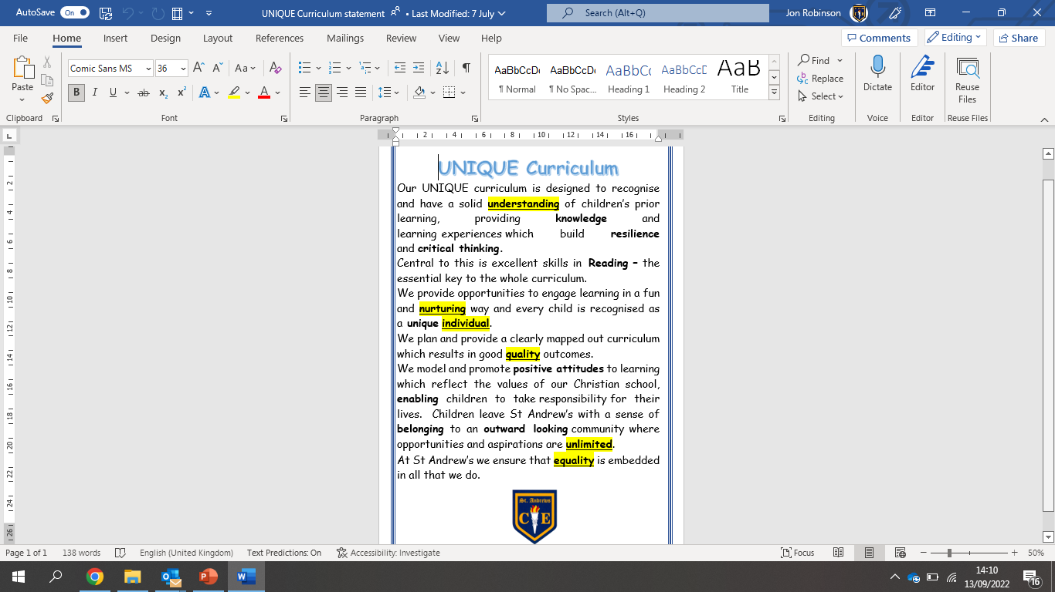
The St Andrew’s UNIQUE Curriculum

Slide 5

What the children will learn and when?

Slide 6
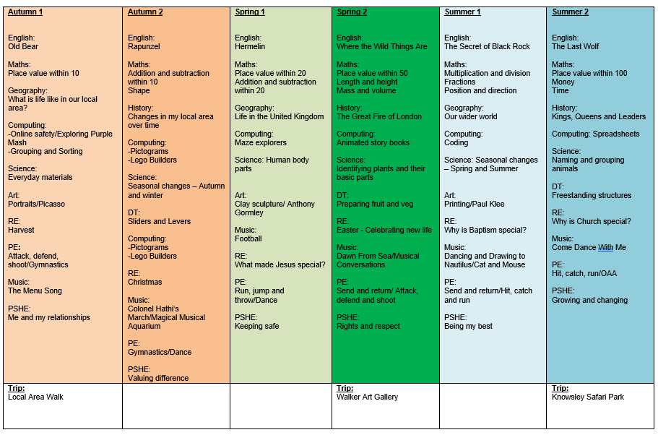
Year 1 Topic Overview

Slide 7

Attendance and punctuality
Attendance at school is very important, as research shows that children who have regular attendance (97% or more) develop more positive mental health, well-being, relationships with their peers are achieve better in school.
This is a trend that we also see for the pupils in our school.
Punctuality – Please ensure your child arrives at the start of the school day at 8.50am, as this is when our children’s learning starts. Children arriving after 9.00am have to enter school through the school office and will be given a late mark.
If a child arrives at 9.00am three times a week they end up missing over 3 days of learning by the end of the school year.

Slide 8

Absent from education…
Attendance has long term impacts on a child’s life chances, including attainment, employment prospects and future earnings. Every professional that interacts with a child or young person of school age, or their family, has a role to play to help them to attend school regularly.
Research highlights children being absent from education for prolonged periods and/or on repeat occasions can act as a vital warning sign to a range of safeguarding issues including neglect, child sexual and child criminal exploitation - particularly county lines.
Notes:
ADD your settings figures to this slide for PA’s and severely PA’s.
Discuss what a PA and sever PA is. Share data for your setting.
Discuss the settings approach to improving attendance.
Explain this is a national, local and setting focus as the links to being absent from education and then being at risk of other safeguarding issues is evident in data and research e.g. exploitation.

Slide 9
How do we reward our children’s positive Attendance?
Weekly Whole School 100% Attendance Wheel – Child gets a prize from school.
Star in the Jar – Every day a class has 100% they earn a star for their jar. 10 Stars in the Jar = Class Reward afternoon.
£5 attendance award for the class with the highest attendance.
Weekly Popcorn award for the class with the highest attendance.
100% Attendance Certificates
97% + Attendance Raffle for the whole school year. Winning prize = £100 Amazon Voucher.
This half term, the class with the best attendance will have a Silent Disco on Thursday 23rd October!

Slide 10
Handwriting at St Andrew's
Here at St. Andrew's Church of England Primary School, we know that handwriting increases children’s motivation: their belief in themselves as writers is predicated on this, particularly in their first years at school. Writing involves many processes, so having fluent handwriting is one less thing to think about.
Pupils are taught handwriting precisely, in a clearly sequenced progression, starting from Reception, to support their gradual acquisition of skills.
We do this using the Read Write Inc approach, including Letter Village from Year 1 to Year 6.
Our school staff expect consistently high standards, making sure pupils practise handwriting regularly and consistently to develop and maintain fluency and legibility. Handwriting is taught daily at school.

Slide 11
Letter Village for Handwriting
Stage 2 begins during Year 1. Children learn the relative size of letters and to form letters that will flow easily into a joined style.
Stage 3 follows on in Year 2. Children learn how to join letters using two basic joins – the ‘bridge’ join, the ‘hill’ join and the two variations on each.

Slide 12
Letter Village for Handwriting- we are on Stage 2
Tonight, you will take home a copy of the QR codes linked to our class handwriting stage if you would like to further support your child with their handwriting at home. These QR codes will take you directly to the Letter Village video links. All of the Handwriting Stage QR codes can also be found on the Handwriting page on our school Website – please follow the home- learning links.
Each term, your child will come home with a new set of QR codes for the term ahead.
Please also see the Examples of letter formations and joins from Stage 1 to Stage 4 on our Handwriting Webpage.
To help your child with handwriting at home using our Letter Village approach, focus on short, engaging, daily practice that uses memorable visual cues and stories rather than mindless copying.
Please follow this link for more information about Handwriting at St. Andrew's https://www.standrewsmaghull.com/page/?title=Handwriting&pid=172&action=saved

Slide 13

Reading at St. Andrew's
Reading is central to the school and year group curriculum. Each half term, the children will be exposed to multiple high quality texts, chosen so that they tie into or complement learning.
These will include:
A ‘Vehicle text’ in English to inspire writing
A Reading for Pleasure text that we will read as a class (normally at the end of the day) to inspire fantastic reading attitudes and, quite often, to support learning across the curriculum.
Family Library dates will be published soon – please join us – these will be open to all years on Thursdays before school.

Slide 14

How to support your child's reading
It’s vitally important for the children to read at home at least five times per week
Your child’s reading record should be signed by an adult whenever they have read and comments can be made by the adult if they wish.
Reading books and records must be brought into school on Fridays for book change.

Slide 15
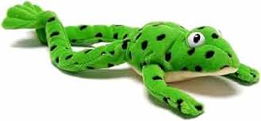
Reading and Spelling is taught through phonics
Phonics is taught through Read Write Inc sessions. The children are assessed every half term and groups are rearranged accordingly.
Phonics Screening Check – children will be well prepared for this throughout the year. Mrs Dwan is our administrator for the check. It will take place in June, just after the half term break. (Week beginning Monday 14th June 2027.) The pass mark for the 2026 screening was 31 out of 40.
Guided Reading – If your child completes the RWI program in Year 1, they will move into the guided reading group with Mrs Zanobini. Here, they practice reading comprehension skills.

Slide 16


Slide 17
Writing at St. Andrew's
We use Ready Steady Write by Literacy Counts to provide a high-quality, inspiring writing curriculum.
This comprehensive program is built around engaging, vocabulary-rich anchor texts (vehicle texts) that spark children's imaginations.
Our current Vehicle Text is Old Bear by Jane Hissey.
It offers a clear, structured sequence for teaching writing—ensuring deep learning, strong talk-for-writing foundations, and consistency across all year groups.
Long Term Plan https://www.standrewsmaghull.com/attachments/download.asp?file=93&type=pdf
Writing is assessed half-termly using the Teacher Assessment Framework with termly moderation within our Trust

Slide 18
What does the writing Curriculum involve?
Vehicle Texts: High-quality, inclusive children’s literature tied to each half-term's topic.
Talk for Writing & Vocabulary: Oracy-led lessons to help children internalize story structures and new words before writing.
Incidental Writes: Shorter writing tasks (like diaries, letters, or in-role descriptions) that build up skills step-by-step.
Working Walls: Interactive classroom displays that track the writing journey, key vocabulary, and models.

Slide 19
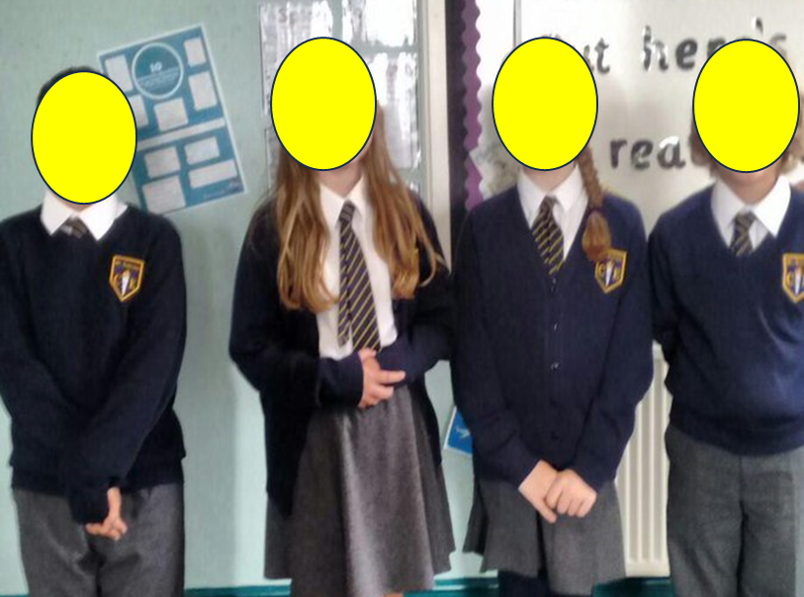
Correct uniform
White shirt or blouse, (to be tucked in at all times),
St Andrew’s tie, (top button to be done up and tie to be smartly fastened),
Grey skirt or trousers, girl’s knee length
White or grey socks or grey tights ,smart black shoes (not trainers),
Blue school jumper with school badge or navy blue jumper in same colour as school badge jumper.
Jewellery – small stud earrings only, watch – no other jewellery (including rings)
Hair – long hair (hair which rests on shoulder or longer) MUST be tied back, hair accessories MUST be small and plain and in school colours.
No nail varnish – children wearing nail varnish will be sent to office to remove it.

Slide 20


Slide 21

School Trips
Library visit
Walker Art Gallery and Crosby beach
Knowsley safari park

Slide 22

PE timetable
PE is on Tuesday and Thursday.
Earrings must be taken out at home before school or covered with plasters.
PE Kit plain navy shorts, plain white t shirt or school t-shirt, trainers. We encourage the children to wear track-suits in the winter months. Children should wear their kit to school on PE days.

Slide 23

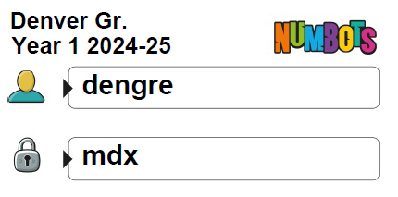
We expect your child to access ‘Numbots’ weekly to support with their fluency within maths and improve their number sense.
A sticker reward system will be used for those who successfully complete each stage.
Children should be encouraged to work independently at home (as they will at school) when accessing to ensure the content is appropriate for them.

Slide 24


Slide 25
Assessment
The children will be assessed regularly by ourselves, as part of our formative assessment cycle
This will help us to inform planning and know what each child needs to do / know to progress further.
This style of assessment takes place in all subject areas
Summative Tests
NFERs in Spring and Summer
Phonics Screening check in June

Slide 26
myHappyMind
myHappymind is an NHS-backed curriculum in primary schools, secondary schools, and nurseries and is focused on building resilience, self-esteem, and happiness in children. We are also using it for PSHE curriculum from this academic year so it will feel more streamlined for the children!
An award-winning programme that has received national recognition for its exceptional work in schools, nurseries, families, and organisations across the UK.
Backed by NHS using preventative strategies firmly rooted in science, research, and the fields of neuroscience and positive psychology.

Slide 27
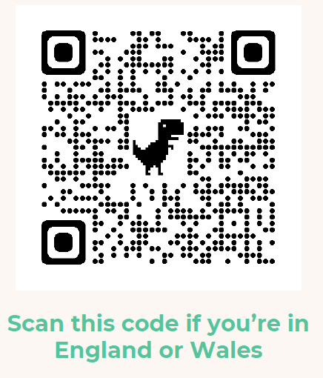
myHappyMind
Philosophy
Proactive not reactive – helping our children to understand themselves and build self esteem before becoming reactive to challenging situations.
Stigma Reversing – when people get the ‘why’ they take action. Understanding science behind our brains.
A systematic approach – a child centred program that includes families and school through the myHappyMind app.
Fun and easy to teach – interactive lessons which are enjoyable for all.
Equal for all – supporting our most vulnerable children.
Your authentication code is 145453

Slide 28

Screen Time & Children's Learning
Children are spending more time than ever using screens, and research suggests that this can have an impact on their wellbeing and education when recreational screen use becomes excessive. Ofcom reports that children aged 8–14 spend almost 3 hours online each day. A 2025 systematic review of 24 studies involving 48,558 children and young people found that higher screen time was consistently associated with lower academic achievement.

Slide 29
Screen Time & Children’s learning
At school, we see the importance of children arriving ready to learn. Sleep, reading, physical activity, conversation and time away from screens all play an important part in children's development. We encourage families to consider not only how much screen time children have, but also what that screen time is replacing. Simple steps such as keeping devices out of bedrooms, having screen-free mealtimes and protecting time for reading, play and family conversation can make a real difference. Our aim is not to remove technology, but to help children develop healthy, balanced and purposeful screen habits.

Slide 30

If you have any questions at all, then please contact me at:
Communication.standrews@ldst.org.uk

