Slide 1

Welcome

Slide 2
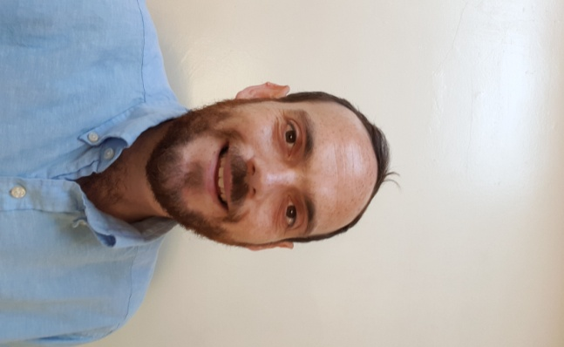
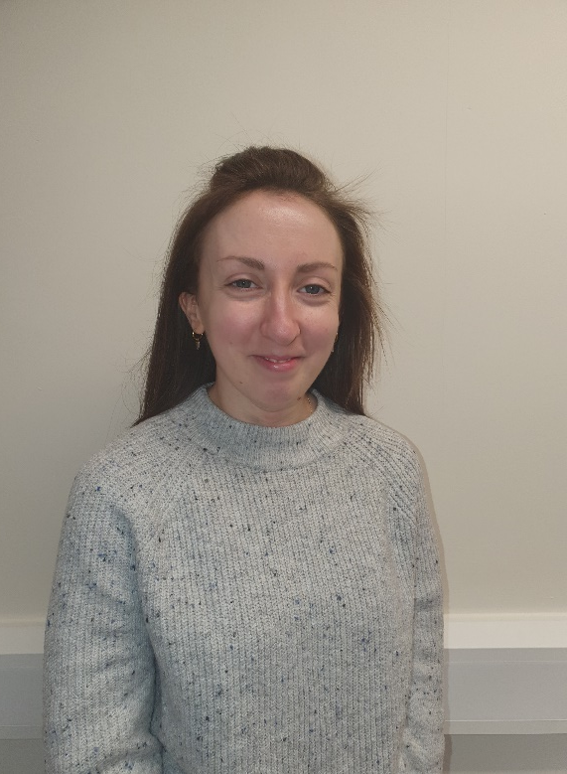
Foundation Stage Staff
Mr Taylor Miss Kerwin
EYFS Lead/Class teacher Key Worker

Slide 3
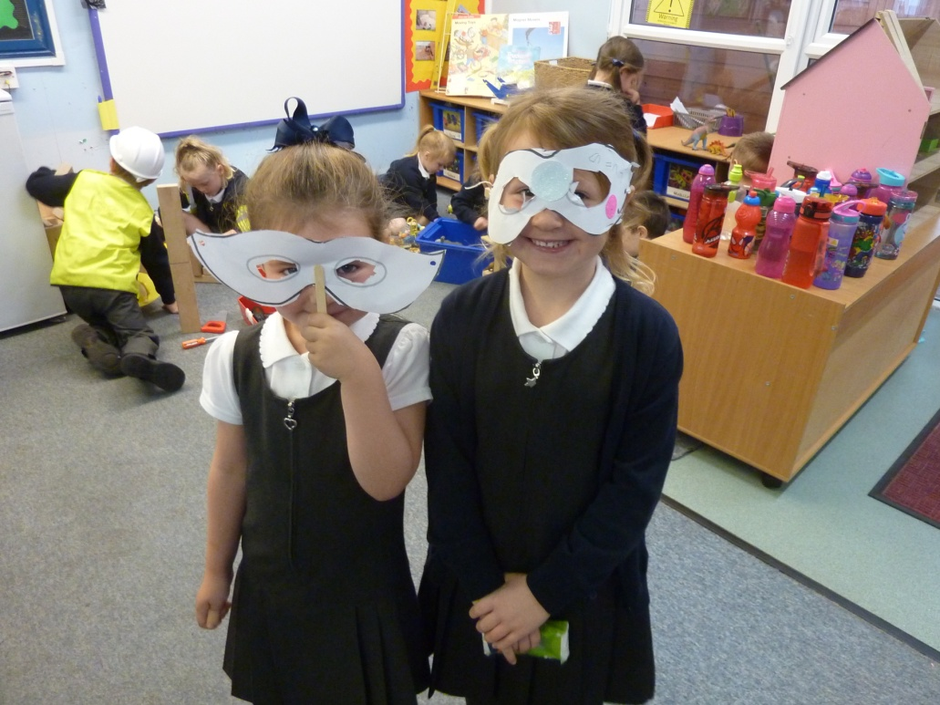
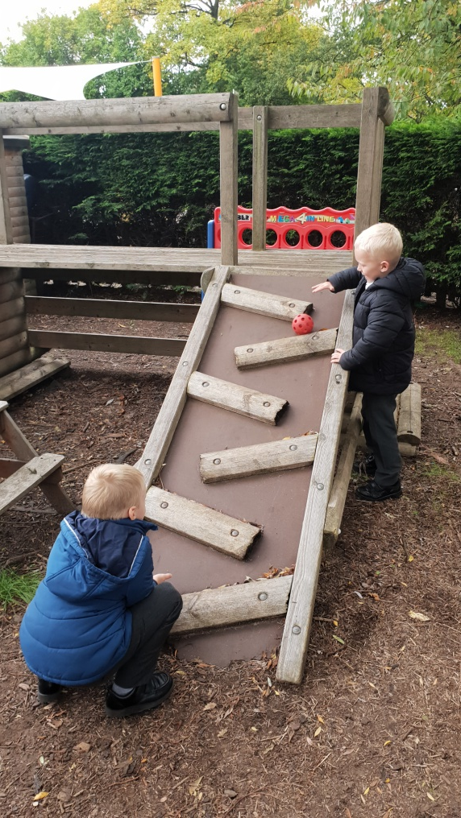
A day in the life of a Reception child...

Slide 4
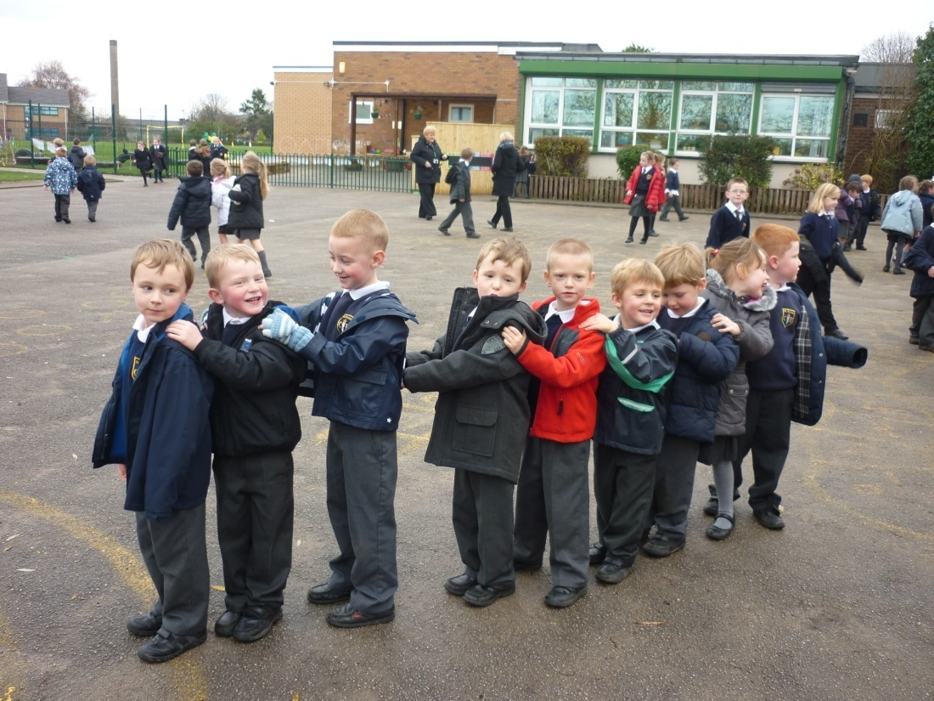
The day begins 8.50
You will walk your child down the infant path and say good bye at the door.
They will then go straight into class to be with their friends and teachers.
This has helped this years class greatly and they settle much quicker.

Slide 5
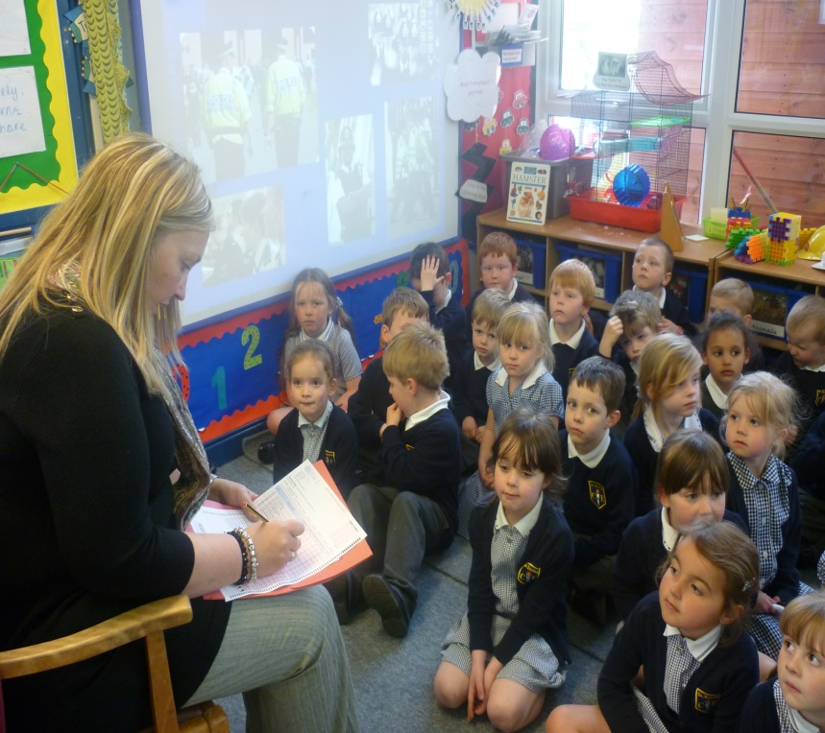
Register 9.00
Teachers take the class register at 9.00 am.
If your child is absent, please try to ring the school office before 9.00am.

Slide 6
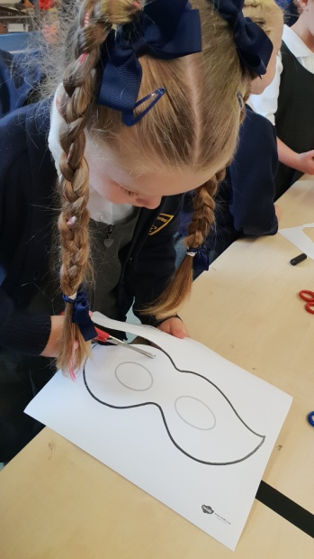
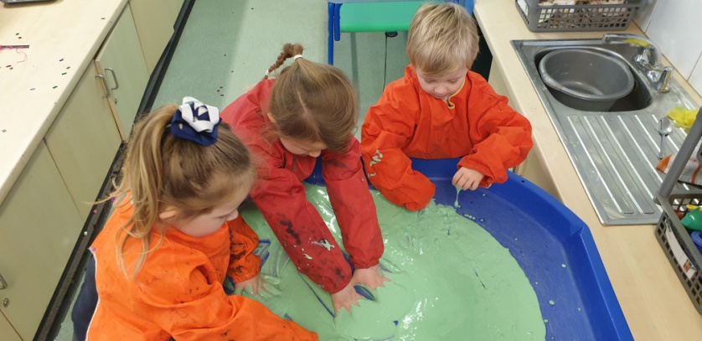
Learning Activities
Each morning the children will take part in small group maths sessions and small group literacy focus sessions. We also complete daily phonics sessions.
They will also have opportunities to work independently, applying the skills that they have learnt, in our structured play areas inside and outdoors.

Slide 7
Structured and Independent play.
A lot of the learning in Reception takes place through play both indoors and outside.
Role play area
Writing table
Workshop
Music area
ICT
Construction and small world
Water
Sand
Dough
Paint
Maths area
Outside Area

Slide 8
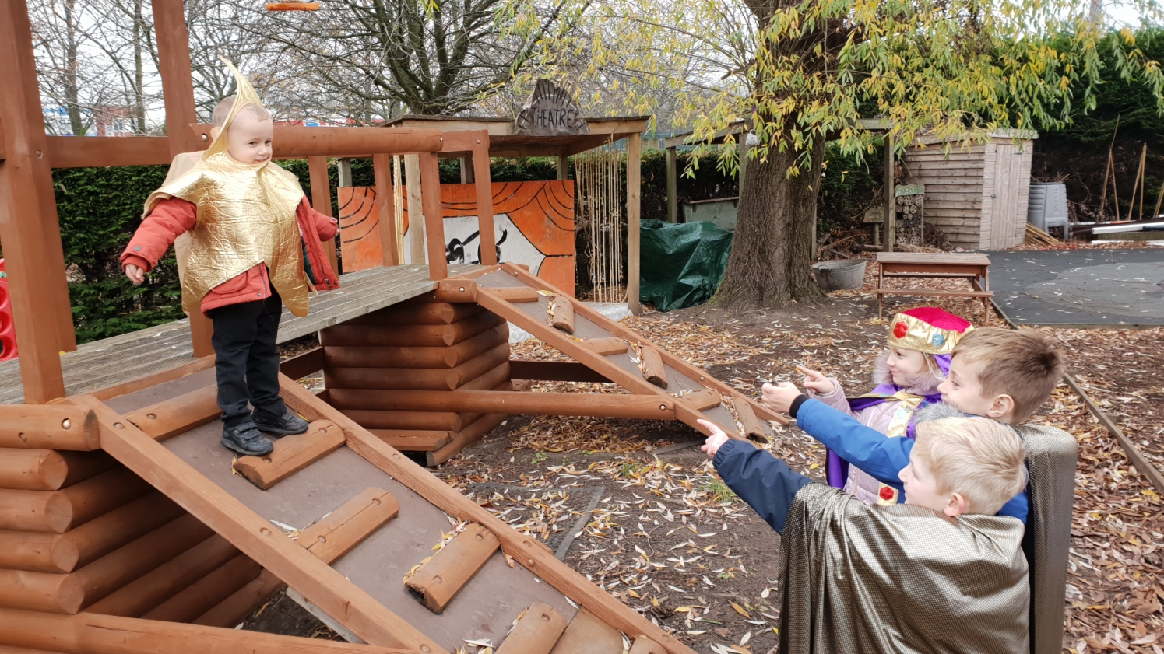
Recreating and inventing stories in the role play!

Slide 9
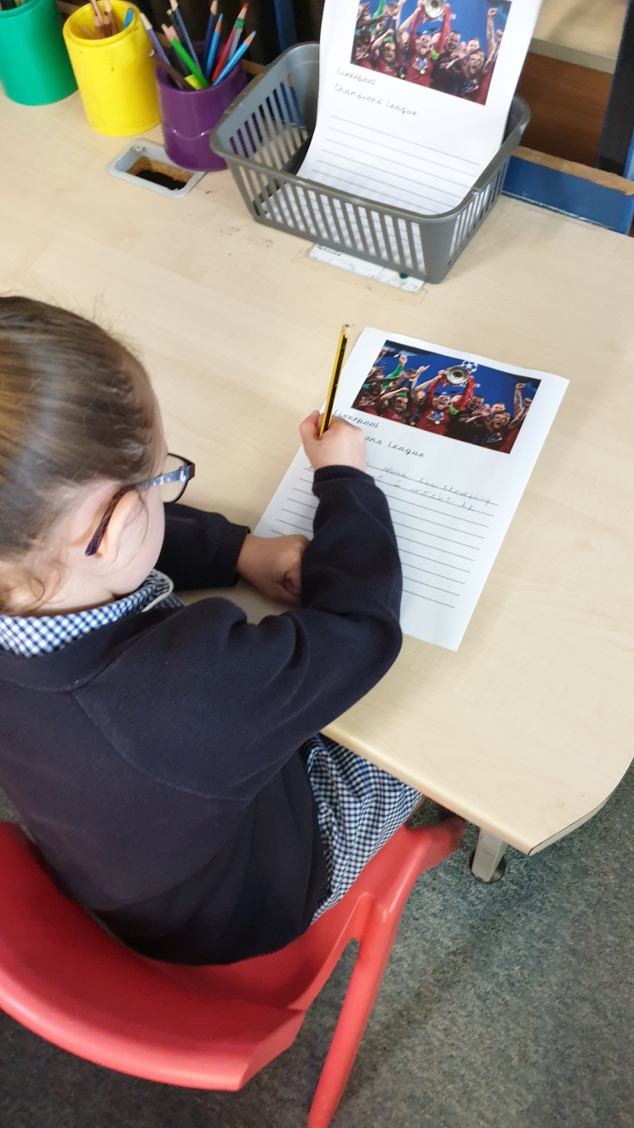
Writing area

Slide 10

Pre Cursive Handwriting
A pre cursive sheet is in your pack.
Helps children to prepare for cursive writing in Year 1 and Year 2.

Slide 11
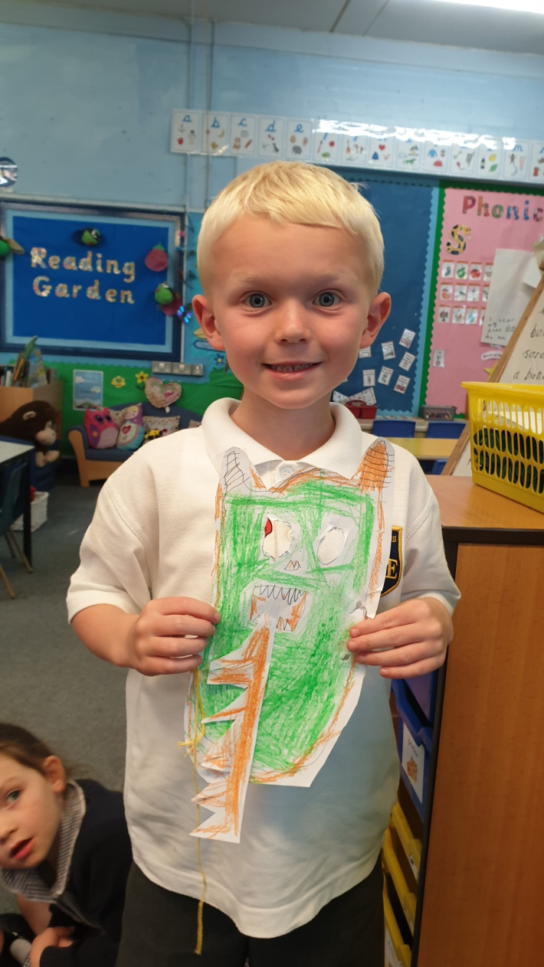
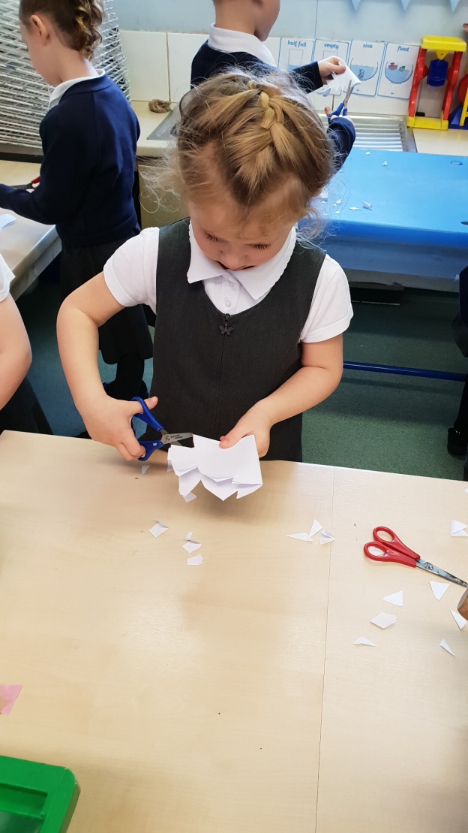
Workshop

Slide 12
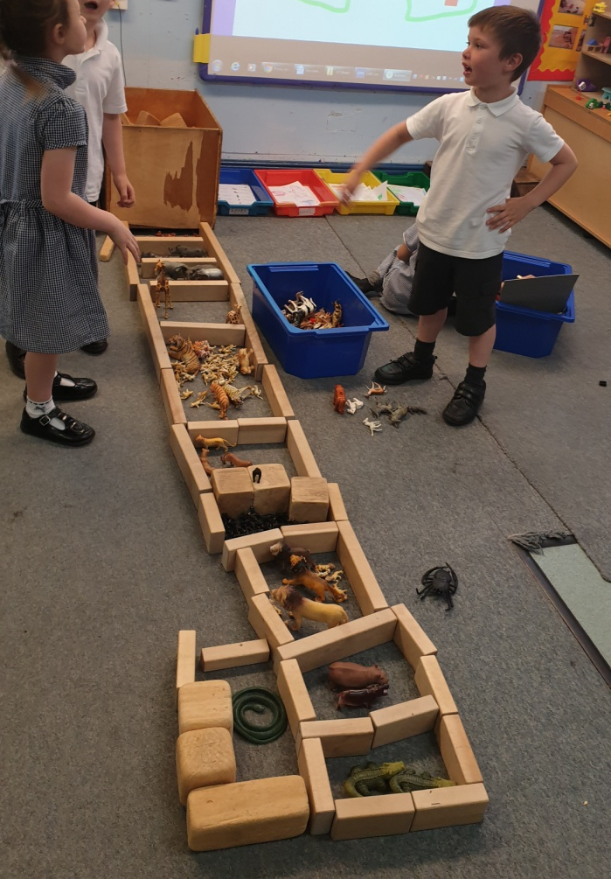
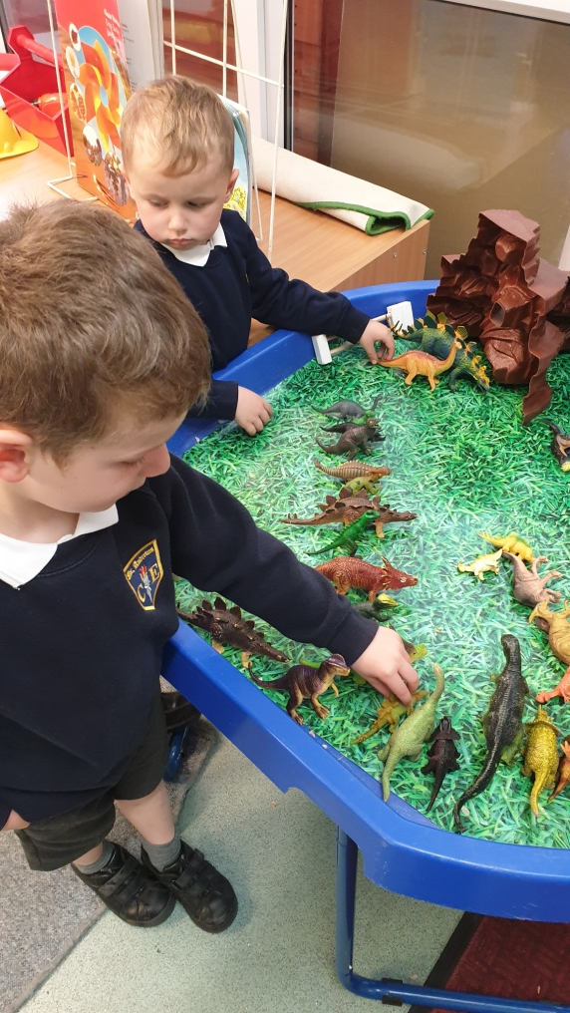
Construction and Small World

Slide 13
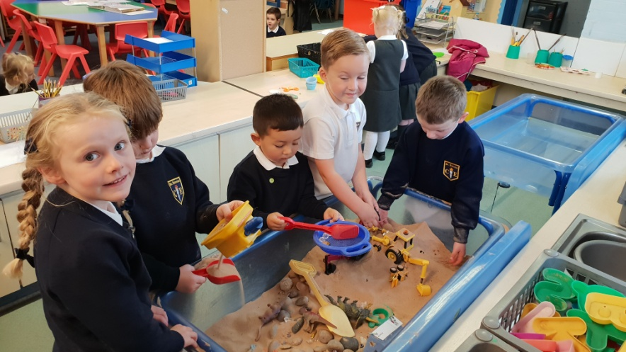
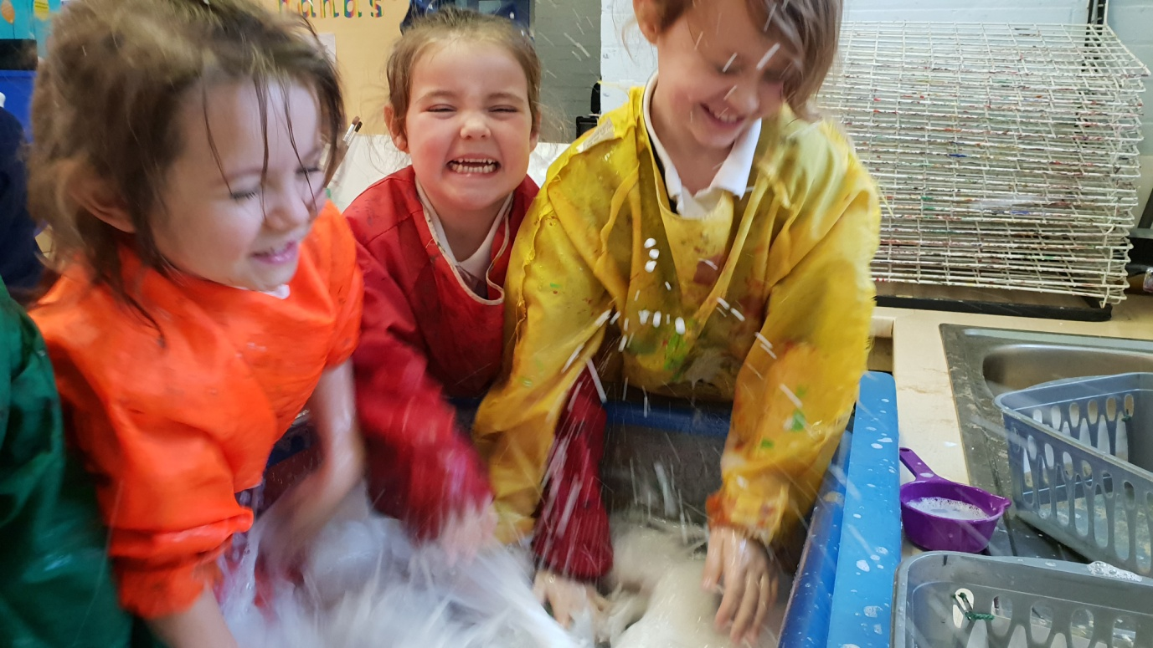
Sand and Water

Slide 14
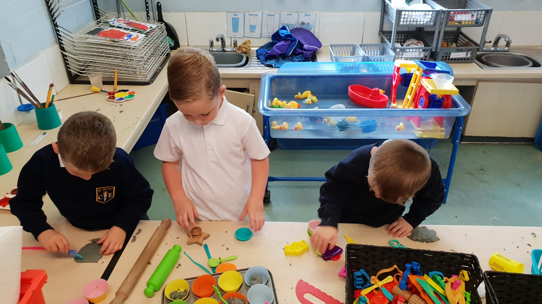
Dough

Slide 15
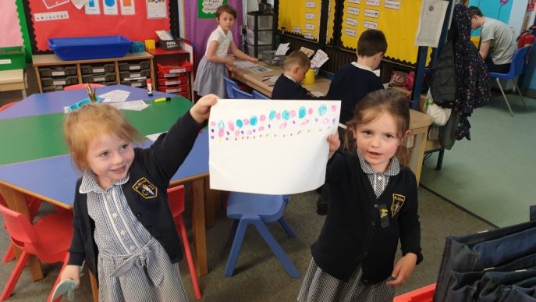
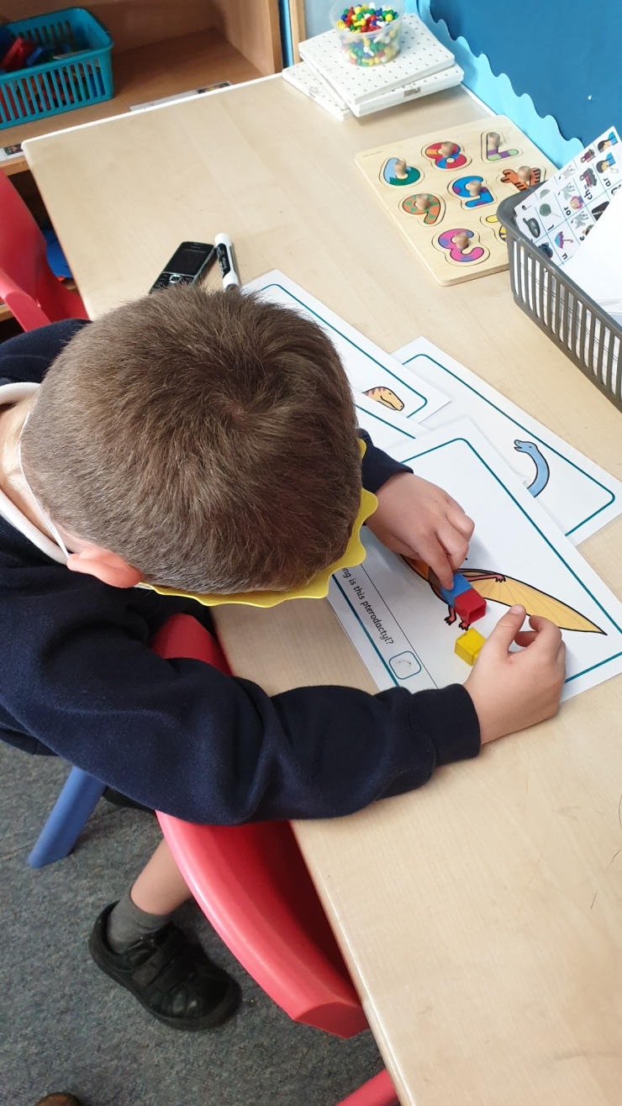
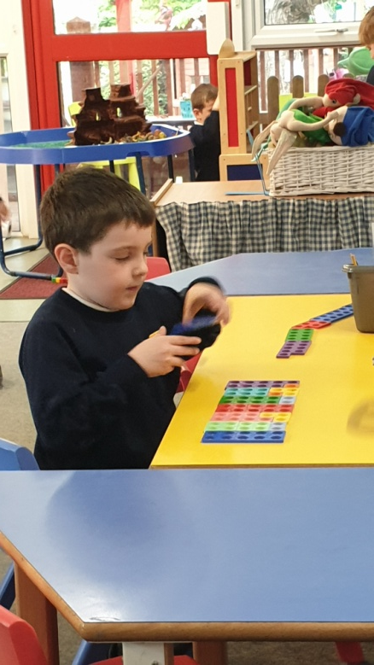
Maths Area

Slide 16
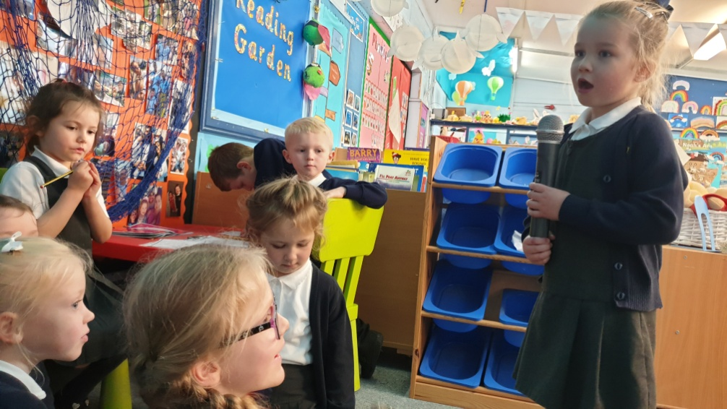
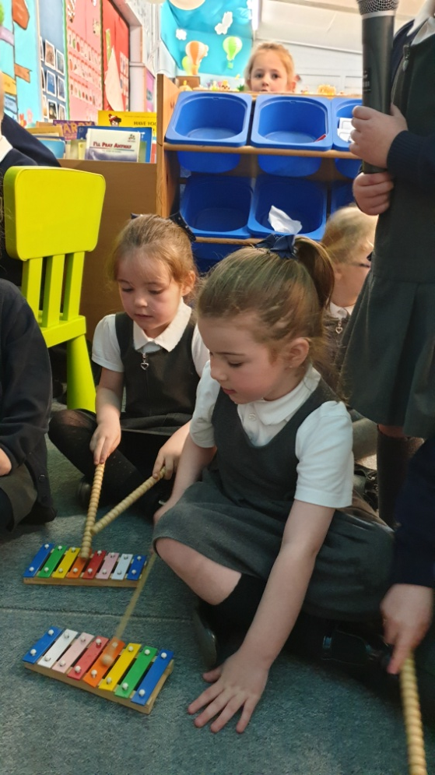
Music

Slide 17
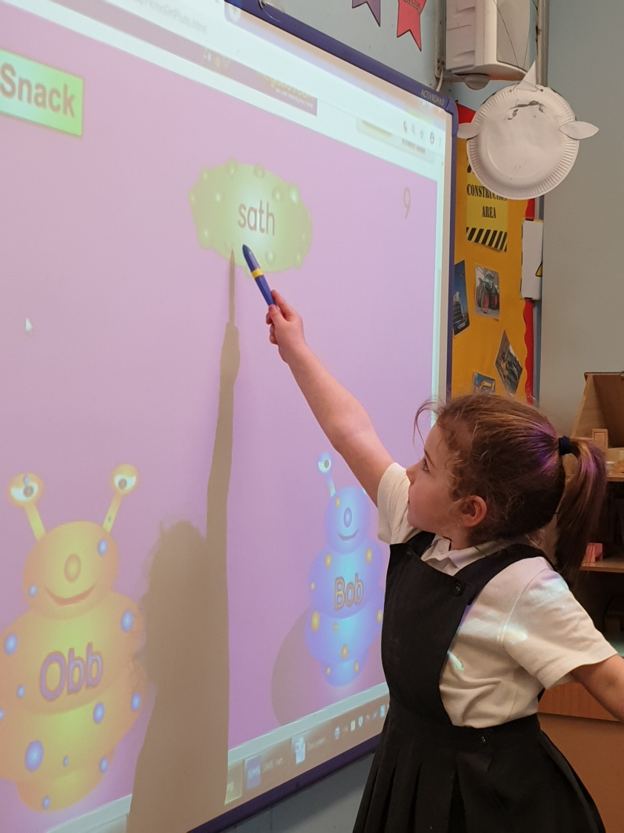
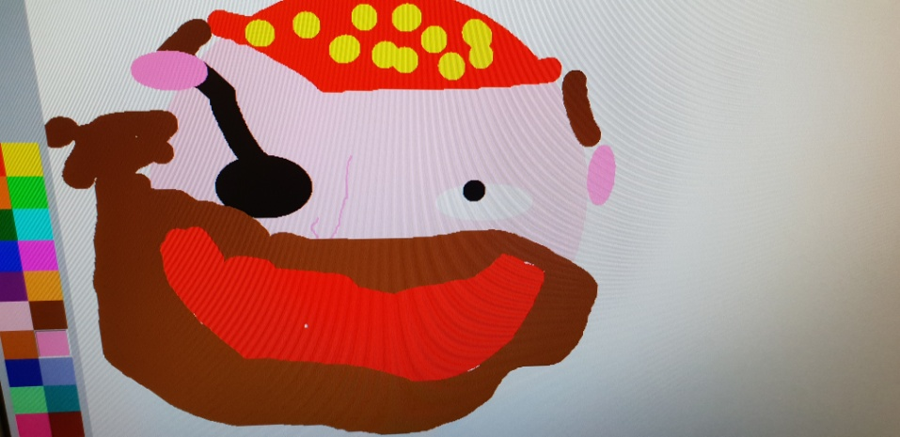
ICT

Slide 18
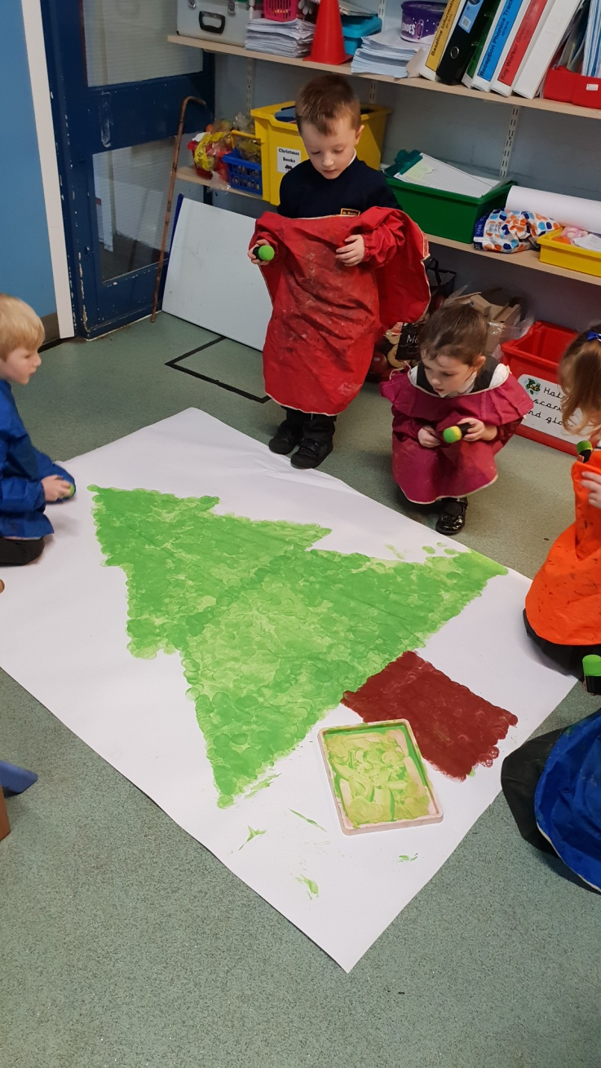
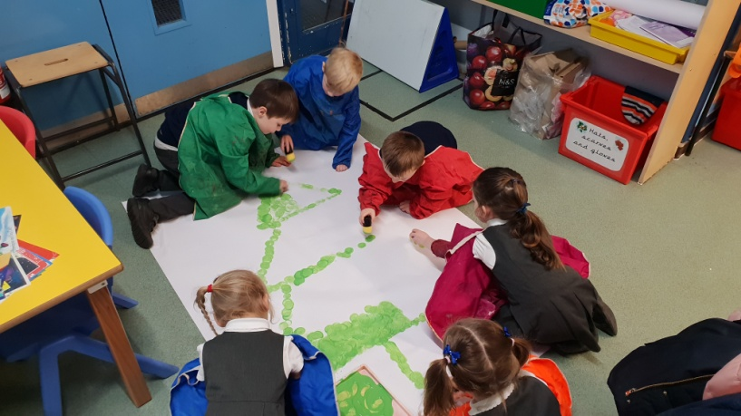
Paint

Slide 19
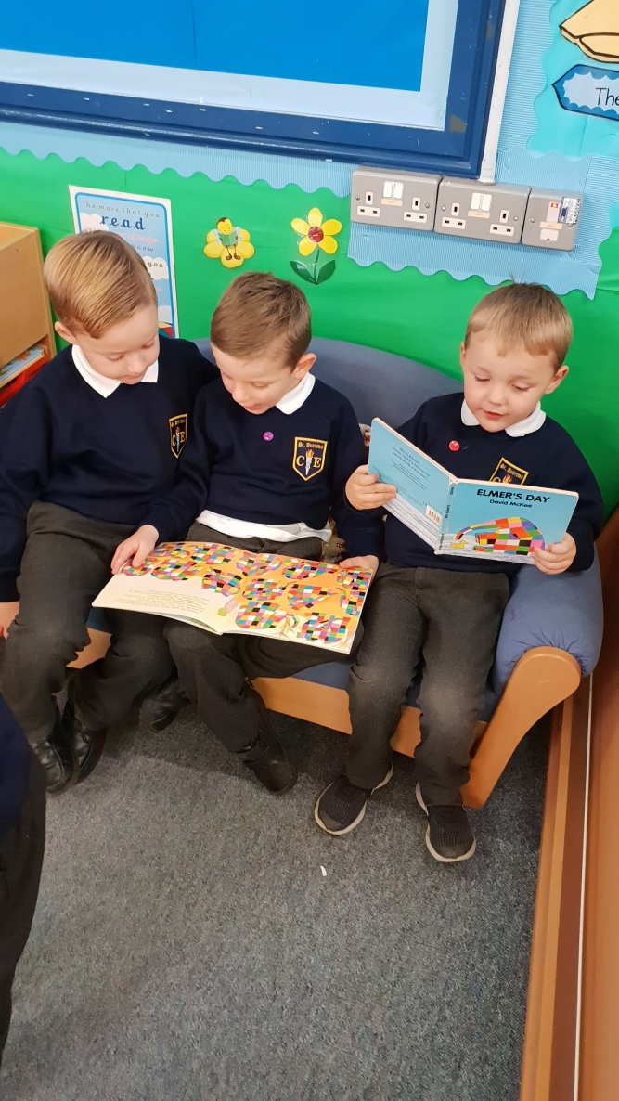
Reading Area

Slide 20
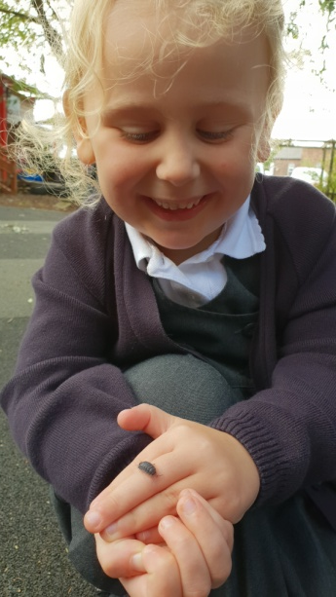
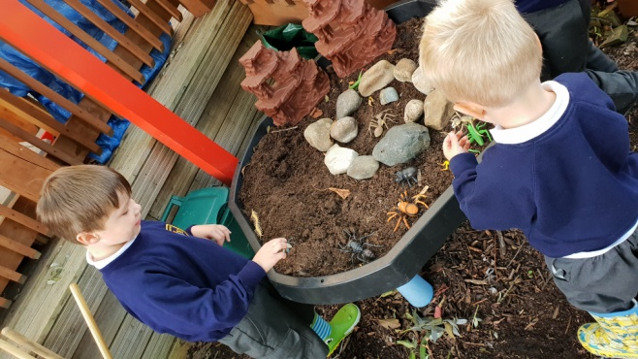
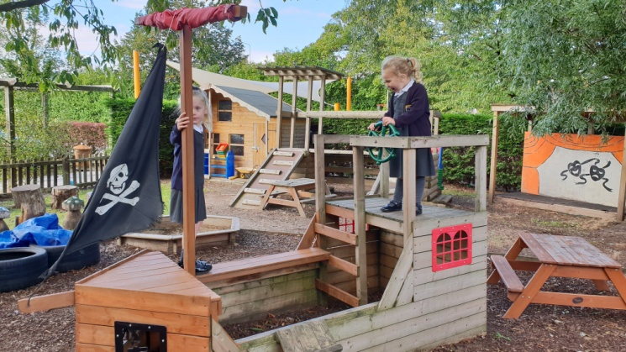
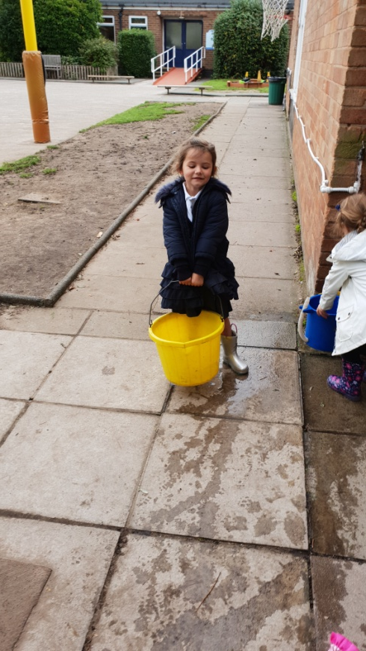
Outdoor Provision
Children may get messy outdoors.
Wellies should be left in school.

Slide 21
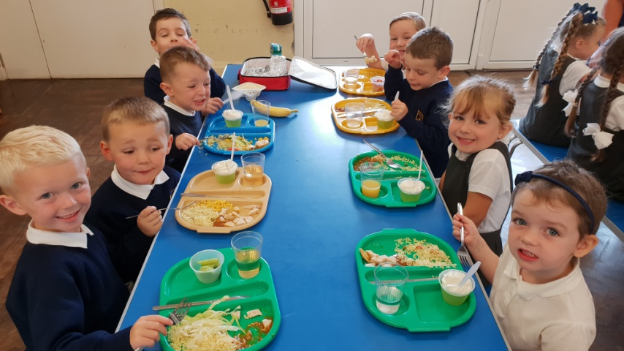
Lunch Time 12.00 - 1.00
Our team of experienced Welfare Assistants will look after your child during the lunch break.
Since September 2015 all EYFS and KS1 children are entitled to a free school meal. The children will eat together in the junior hall. (see form in your pack)
The rest of the lunch break is spent outside in the playground. If it is raining the children remain in their classrooms.

Slide 22


Lunch time
Children should only change from hot dinners to packed lunches or vice versa, at the start of a new half term. You must inform the school office of any changes.
You have been issued with a form from Dolce with information for how to log on to the new system. Your menu choices will be selected online.
All children in Reception will need a packed lunch on their first day.

Slide 23
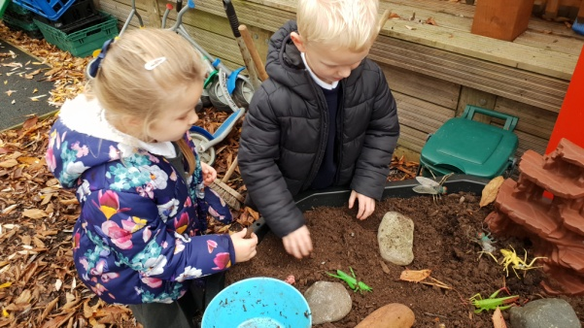
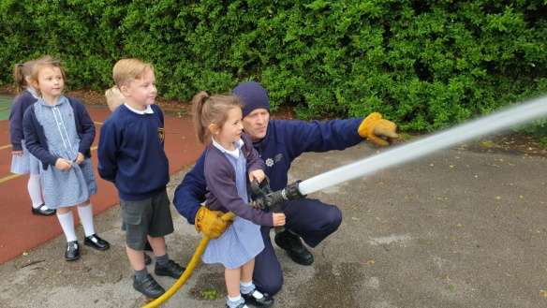
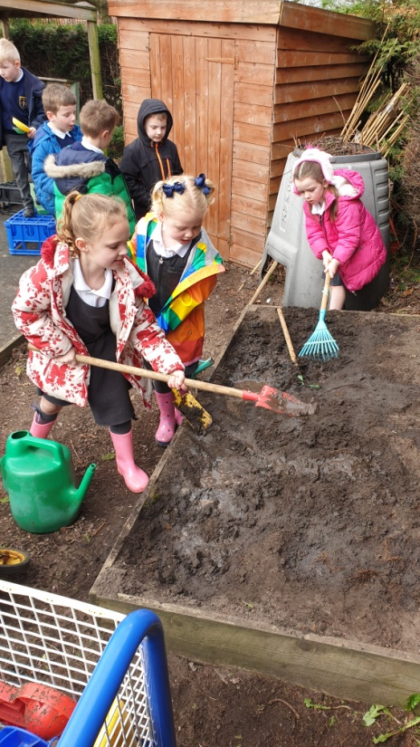
The afternoon
Continuous play provision indoors and outside
Individual reading
sessions
Guided reading sessions
Observations

Slide 24
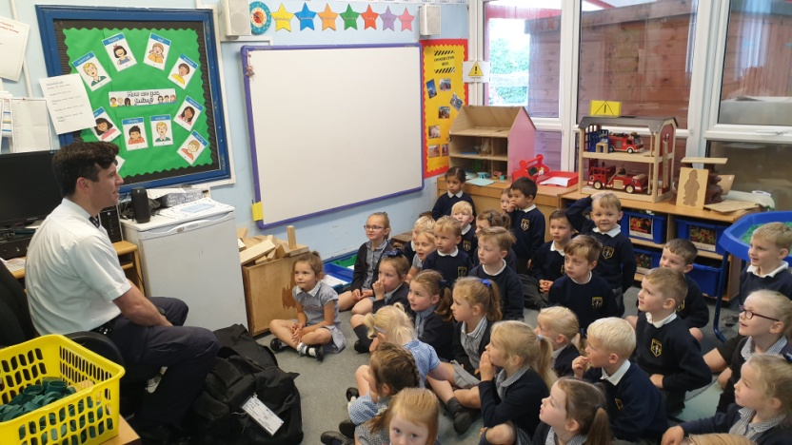
Story time, milk and maybe a visitor!
At the end of each day, the children will share a story and have milk.
We often have visitors pop in to see the children too.
At home time children are picked up from the Reception garden. Children should not play here at the end of the day.
You must inform us of any change of arrangements.

Slide 25
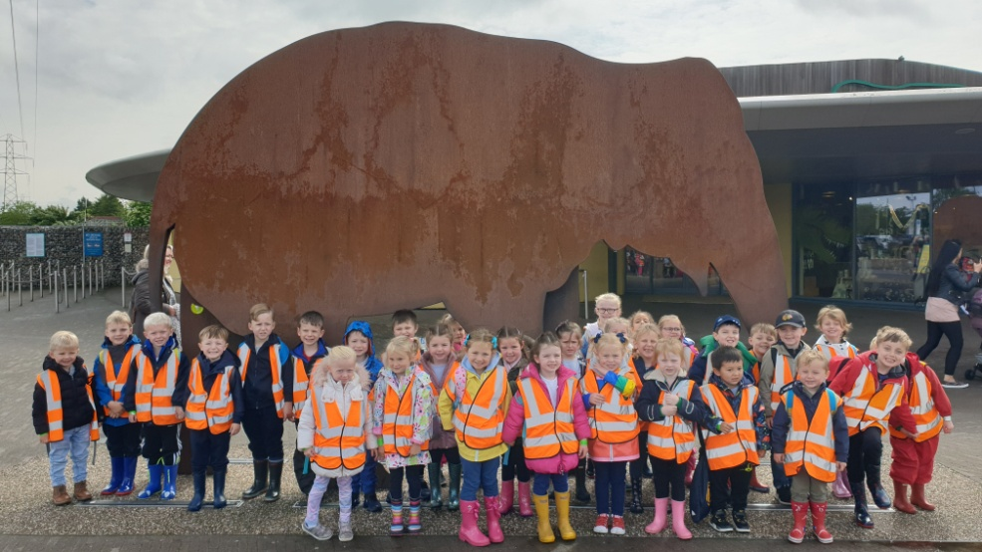
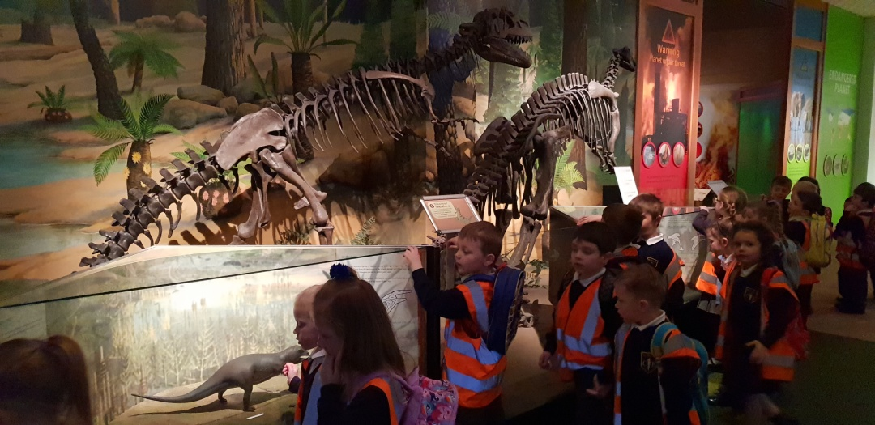
School Trips
A fantastic way of gaining experiences and improving confidence and social awareness.
High child adult ratio
Detailed risk assessments

Slide 26
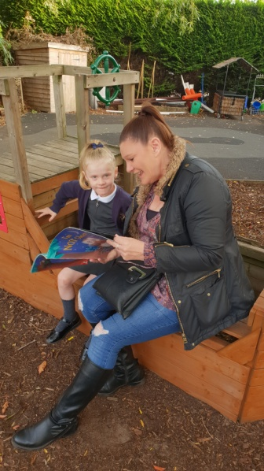
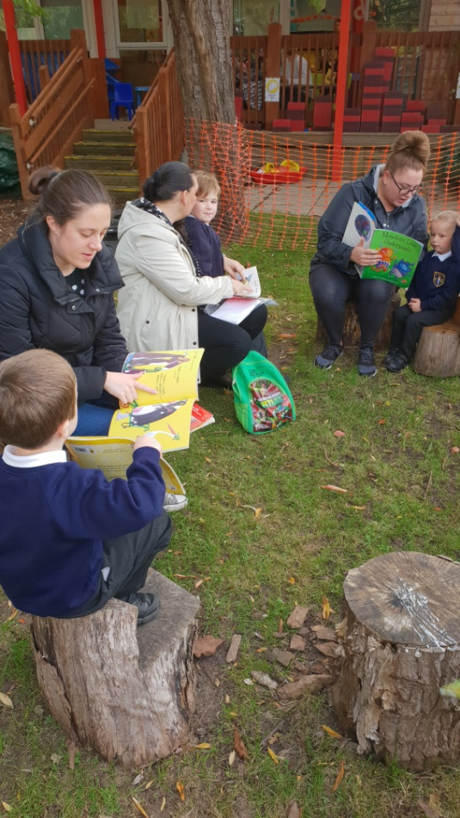
Links to home
Stay and play
Weekly newsletter
Open door policy
Class Dojo
Evidence Me

Slide 27
Using the internet to keep in touch!
School website is updated regularly with school information, class information, photographs etc
www.standrewsmaghull.com
Twitter updated regularly with photographs and news. Follow us @StAndrewsCoE
Parent App – search Apple app store or Google Play.
Class dojo

Slide 28
Pupil Progress
Progress in EYFS is excellent across all 17 ELGs.
Pupil progress meetings take place with all class teachers and SLT to discuss progress and address any issues.
All children made expected or better than expected progress from their starting points for all of the ELGs.
For 2018/19 - 81% of our children achieved a Good Level of Development (GLD) in comparison to 71% nationally (2017/18).

Slide 29
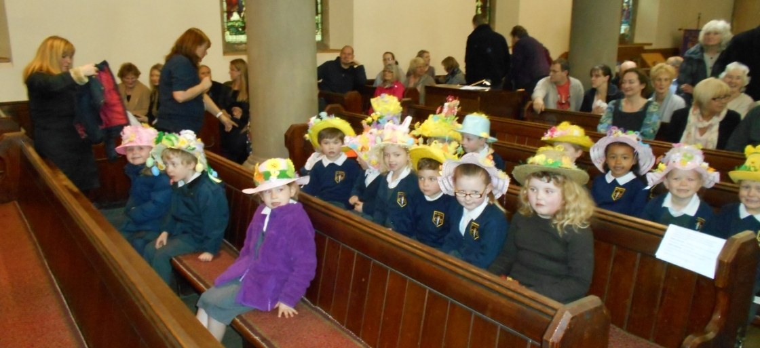
School Church Partnership
Children regularly visit church for collective worship
Every Thursday we have guest speakers from local churches, come into school for collective worship
We explore a different Christian Value each half term
Our SIAMS inspection graded us as ‘outstanding’ in all areas.

Slide 30
School Uniform Providers
Sefton School Wear – can be ordered through school or can be purchased from the shop on Dover Road.
Premier Uniform – can be purchased direct from the shop in Ormskirk
Tesco Online – Some uniform can be ordered online

Slide 31
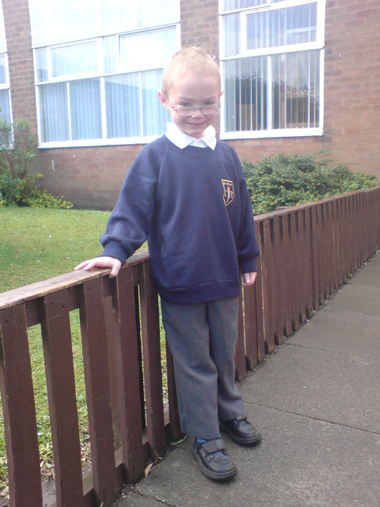
Reception Winter Uniform
Boys
Long grey trousers
White polo t-shirt
Navy round neck school jumper with logo
Grey socks and black shoes
Girls
Grey skirt or slip
White polo t-shirt
Navy round neck school jumper with logo
Grey socks/tights and black shoes

Slide 32
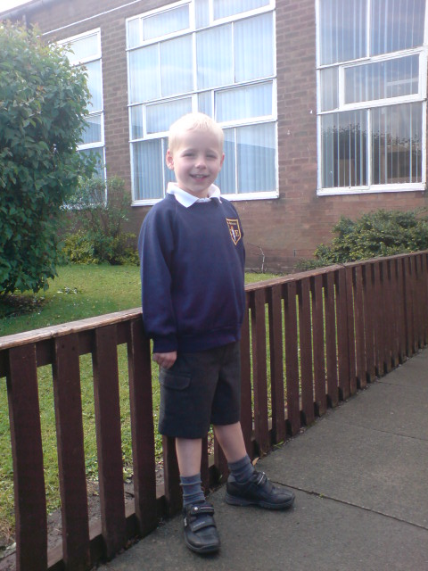
Reception Summer Uniform - boys
Grey shorts
White polo t-shirt
Navy round neck jumper
Grey socks
Grey socks and black shoes

Slide 33
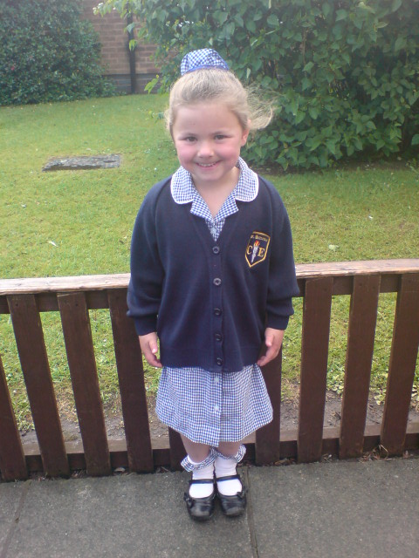
Girls Summer Uniform rec-Y6
Navy blue and white gingham dress
Navy blue cardigan with logo
White socks and black shoes

Slide 34
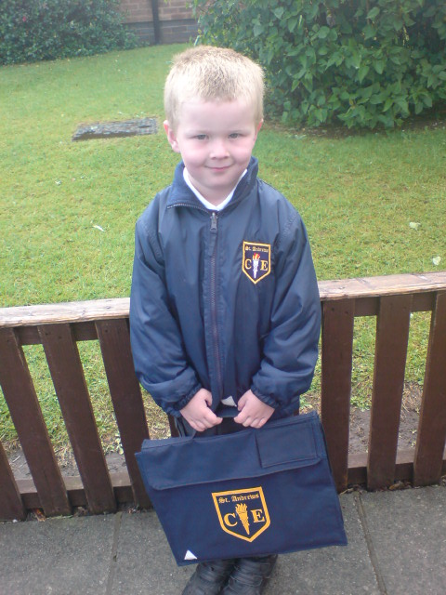
School coat and book bag

Slide 35
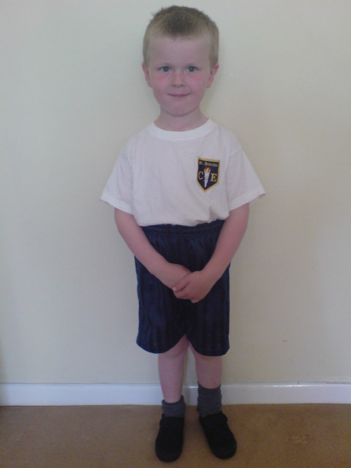
PE Kit rec – Y6
White t-shirt with school logo
Navy blue sports shorts
Black pumps
School pump bag
Winter – Navy blue track suit
Children come in PE kit on Tuesday

Slide 36
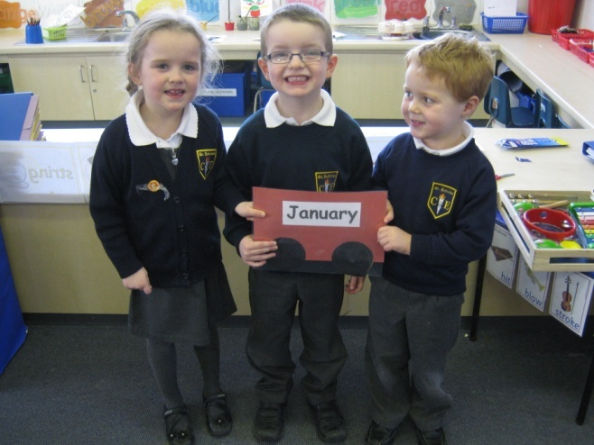
School Uniform
You will find uniform order forms inside you information pack.
Please note all uniform must be labelled with your child’s full name.

Slide 37


Toilet issues
If your child has any toilet issues. Please let us know.
Please provide a bag containing named, spare school uniform, underwear and wipes. The bag should be left in school so that your child always has his/her own clothing available.

Slide 38
What happens about Discipline?
  We encourage and reward positive behaviour as a way of reducing bad behaviour
  All classes create their own rules of good behaviour together
  All staff are involved in matters of behaviour
  We have clear written procedures for poor behaviour and consequences

Slide 39

St Andrews C of E School
Working together for our children!

Slide 40
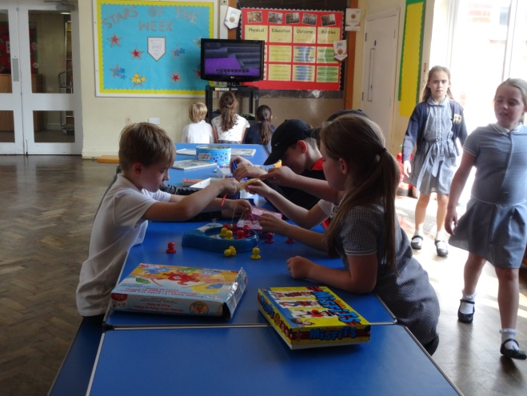
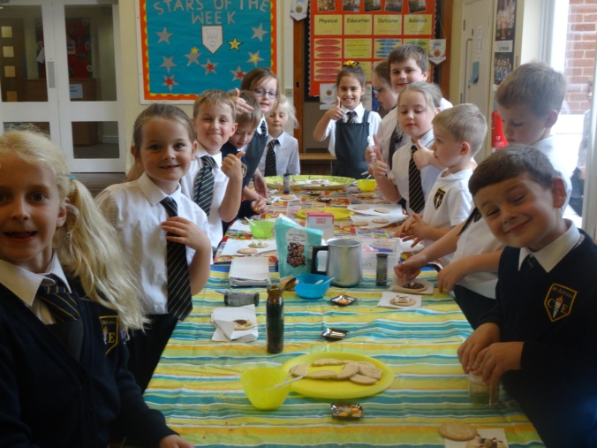
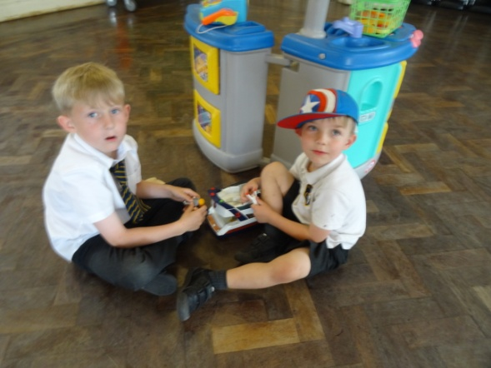
Wrap around care
Breakfast Club
£3.50 per day
7.45 am until 8.45 am

Slide 41


After
School
Club
£10.00 per day
3.20pm until 5.45pm

Slide 42

How can I help in partnership with the school ?
  Children learn a great deal from their parents and teachers. Home and school are the two most powerful influences on your child and they should be seen to be always working together.
        Join or support fundraising as much as you can
  Attend meetings when requested
  Help with homework
  Help in a classroom to gain a better understanding of teaching and learning

Slide 43

How can I help in partnership with the school ?
  Share an interest in your child’s work
  Praise and encourage your child’s efforts
  Listen to your child read
  Visit libraries and bookshops
  Encourage listening to audio tapes
  Sit and watch good television or videos with your child and talk about what you are watching
  Talk Maths with your child all the time

Slide 44

Thank you
We are really looking forward to getting to know you and your children and we hope you are excited too!
Any questions in the chat please

