Slide 1


SATs Briefing 2026
02.03.2026

Slide 2
Year 6 SATs Briefing Session
Introduction
English
Maths
Supporting your child at home
Questions

Slide 3
SATS Week Dates
The 2026 Key Stage 2 (KS2) SATs for Year 6 pupils in England will take place from:
Monday 11th May to Thursday 14th May 2026

Slide 4
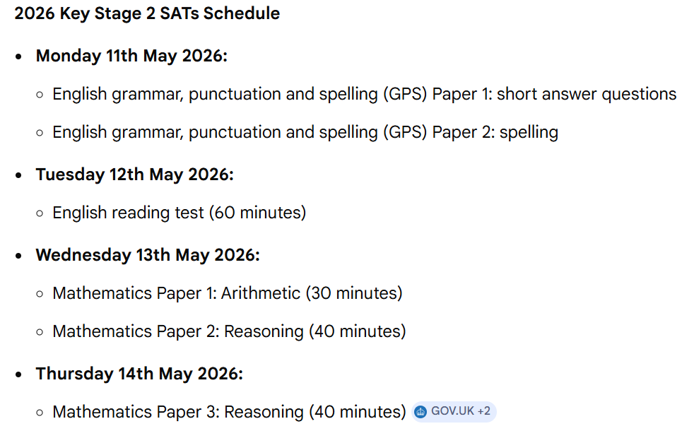
(45 minutes)

Slide 5
Tests
English Tests
  Paper 1 – SPAG – short answer questions – 45 minutes (Total of 50 marks)
  Paper 2 – Spelling – 15 minutes (20 marks)
  Total of 70 marks
  Reading Paper – 1 hour (50 marks)
Maths Tests
  Paper 1 – Arithmetic – 30 minutes (40 marks)
  Paper 2 – Reasoning A – 40 minutes (35 marks)
  Paper 3 – Reasoning B – 40 minutes (35 marks)
  Total out of 110

Slide 6
Scores on the test
For the KS2 tests a scaled score of 100 represents the ‘expected standard’
The scaled score will be based upon the pupils’ raw score.
80 is the lowest scaled score that can be awarded
120 is the highest scaled score
The raw score is their total number of marks they receive in the test.
A conversion table will be used to translate raw scores into scaled scores.

Slide 7
Results
Results will be published in July and shortly after they have been published each child will receive:
  A scaled score
  Confirmation of whether or not they have reached the expected standard for the end of KS2

Slide 8
English
All pupils will sit the same papers.
Tests
  Reading Paper - 1 hour
  Grammar, punctuation, vocabulary - 45 minutes
  Spelling - 15 minutes
  Writing – teacher assessment over the year

Slide 9
Reading Test
One hour to read a booklet containing 3 or 4 different text types and answer questions about these texts.
Types of text: story/report/diary/web pages/journal/letters/comic strip/advertisements
Types of questions could include:
  inference/deduction/understanding
  interpret/ explain/comment
  writer’s viewpoint, purpose or use of language/structure and organisation of the text
  Identifying / commenting on new language meaning in context (wide vocabulary needed) e.g. What impression does this give.... What does this suggest about the character....

Slide 10
Examiners are looking for pupils who can:
Infer and deduce
Follow instructions
Use and identify varied/technical vocabulary
Write in full sentences (to a degree) with a good range of punctuation/appropriate sentence length
Make informed and reasoned predictions about texts, setting and character
Make a valid / reasoned point and support it with evidence
Grammatically accurate answers – correct pronoun from text, missing words etc

Slide 11
Grammar and Punctuation Test
Word classes – nouns, adjectives, determiners
Features of sentences – statements, commands, questions
Complex sentences – clauses, subordinating connectives
Standard English – tenses, contractions
Vocabulary – synonyms, antonyms, word meanings, prefixes and suffixes, singular and plural
Punctuation – capital letters, commas, inverted commas, apostrophes, ellipsis, colons, semi-colons, hyphens and dashes
Spelling must be accurate throughout – it’s all about attention to detail!

Slide 12
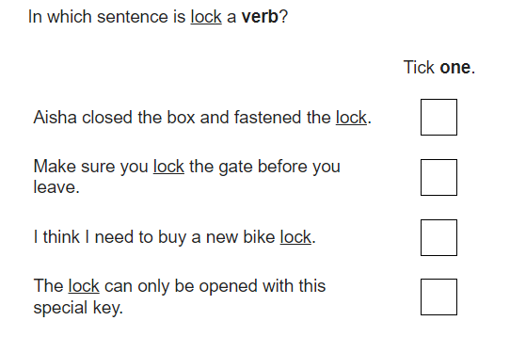
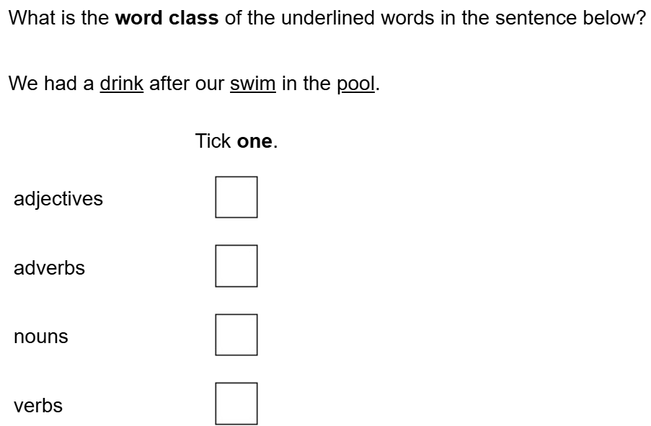
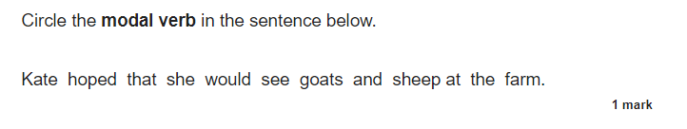
GPS Examples

Slide 13
Spelling Test
20 sentences with words to complete:
We sat at the table to eat our ________ (dinner)
The plants _______ butterflies (attracted)
The dancers’ movements were _____ (synchronised)

Slide 14
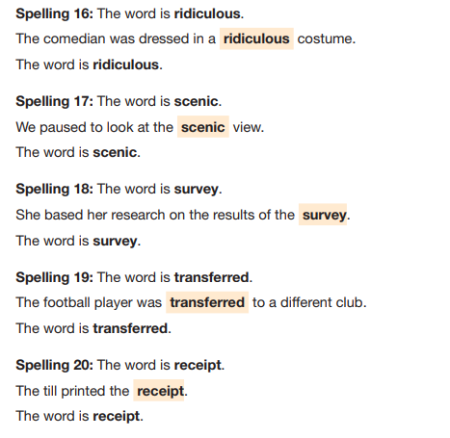

Slide 15
Writing
The overall writing judgement will be made by looking at pupils’ work over the course of the year. This will be moderated internally, by other local schools and possibly by an external moderator.
The range of styles include:
  Narrative, Poetry, Recount, Report, Instruction, Procedure, Explanation, Persuasion, Argument
  Cursive handwriting - imperative

Slide 16
Ways to help at home - Reading
Read a range of non-fiction and fiction texts – identify the features of the texts.
Listen to your child read – ask questions about their reading.
Find different types of texts in your home. Talk about WHO they are written for / WHY they have been written / WHAT style has been used / WHEN the text style is used / WHERE these texts are found / HOW the texts have been organised.

Slide 17
Ways to help at home - Spelling
Post-its
Spelling rules
Point out spellings around the house/in shops/on outings
When listening to your child read, point out certain spellings
Diaries– write down the spelling of new words / learn the meaning of these words
Note words and their spellings in the context of the sentences

Slide 18
Ways to help at home - writing
Vary sentence structure
Begin sentences with different words
Use a variety of punctuation
Use a topic sentence to begin paragraphs
Encourage description and expand detail

Slide 19
Maths
Three Parts:
Paper 1 Arithmetic 30 minutes.
  36 questions worth a total of 40 points.
Paper 2 & 3 Reasoning 40 minutes each.
  worth a total of 35 points each.

Slide 20
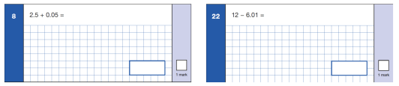
Maths Paper 1 – Arithmetic
Speed and choosing when to use formal method or mental / jottings

Slide 21
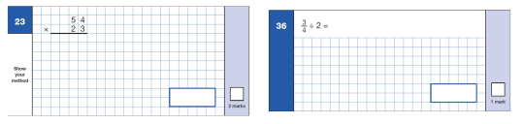
Maths Paper 1 - Arithmetic

Slide 22
Complex, multi-step problems
A square tile measures 20cm by 20cm.
A rectangular tile is 3cm longer and 2cm narrower than the square tile.
What is the difference in area between the 2 tiles.
Calculate area of square tile (knowledge of formula) 400cm squared
Calculate the side lengths of the rectangle 20 + 3 = 23cm and 20 – 2 = 18cm Use formula to calculate the area 23 x 18 = 414cm squared
Find the difference between the 2 areas. 14cm squared

Slide 23
Maths – Style of papers
Children are becoming more familiar with the style of papers from their time in Year 6. We will continue to work on this
In lessons, children will continue to use questions from papers to practise the skills they are learning
Children have completed assessments in December (sent home) and will complete some in March and then regular small SATS style tasks before May to ensure they are prepared
Arithmetic daily (twice a day) and Friday papers – going home each week

Slide 24
Ways to help at home - Maths
One of the most important ways is to sit down and talk to your child:
Discuss what they have been doing in each Maths lesson. Ask them to explain.
Be careful with Calculation Methods – some pupils will be using informal methods – ask your child to explain the method they use.
Daily use of Timetable Rockstar at home – building on times table knowledge and speed, along with division facts.
Arithmetic –Coming home each Friday!

Slide 25
Ways to help at home - Maths
Many questions involve solving a problem and working in context.
Ask questions about the world around them, involving:
telling the time, differences in time, reading bus and train timetables, T.V schedules, cooking times, 12 and 24hr clock etc.
measuring, estimating, checking – length, area, capacity/volume, mass/weight, temperature (positive/negative), angles etc.
money, shopping bills, change, tickets etc.
working out fractions and percentage of quantities

Slide 26
SATs week
Breakfast will be offered to the children from 8:15am.
Sausage and bacon butties or toast!
We have a prompt start at 8:50am (registers completed).
It is not compulsory for your child to attend breakfast, but they must be at school no later than 8:50am.

Slide 27
Questions?

