Slide 1

Meet the Teacher
Year 5 with Mrs Bell
September 2025

Slide 2


Together in God’s love, we learn, inspire and grow

Slide 3
Year 5 Staff
Mrs Bell
Miss Lowson
Mrs Robinson/Mrs Calleja

Slide 4

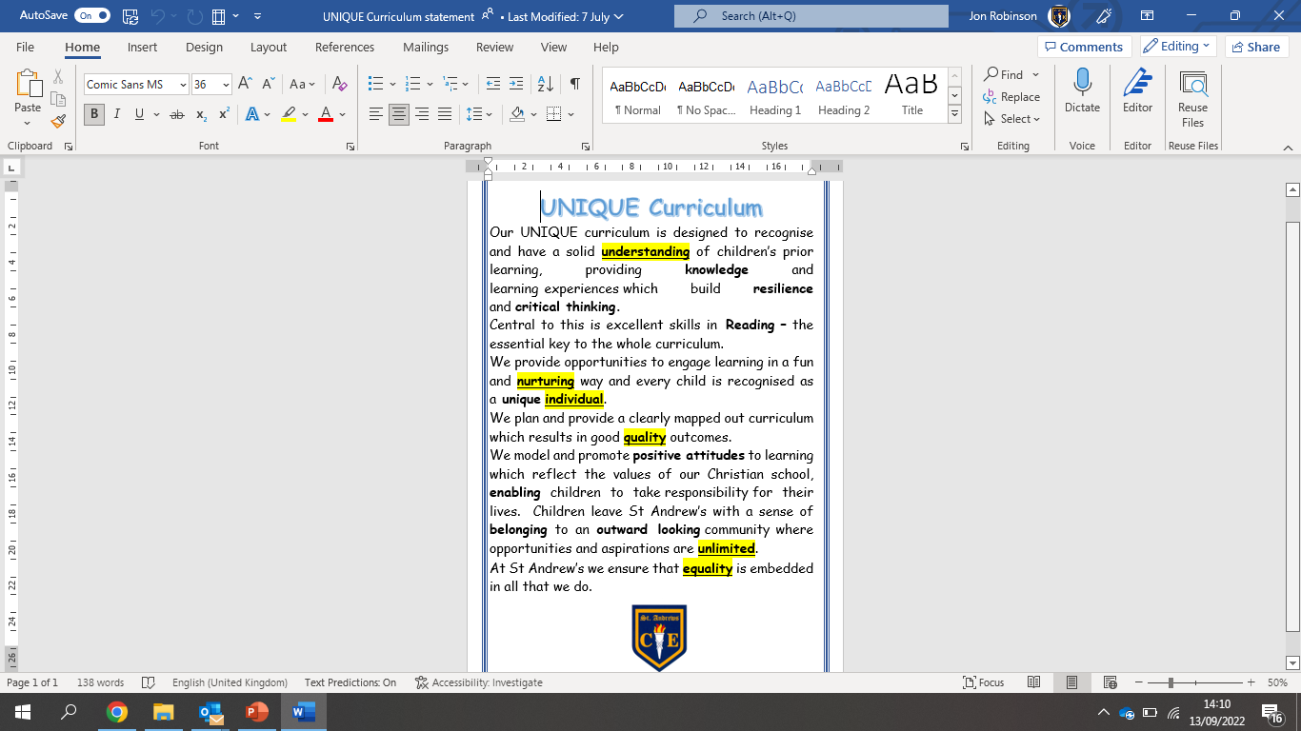
The St Andrew’s UNIQUE Curriculum

Slide 5

What the children will learn and when

Slide 6
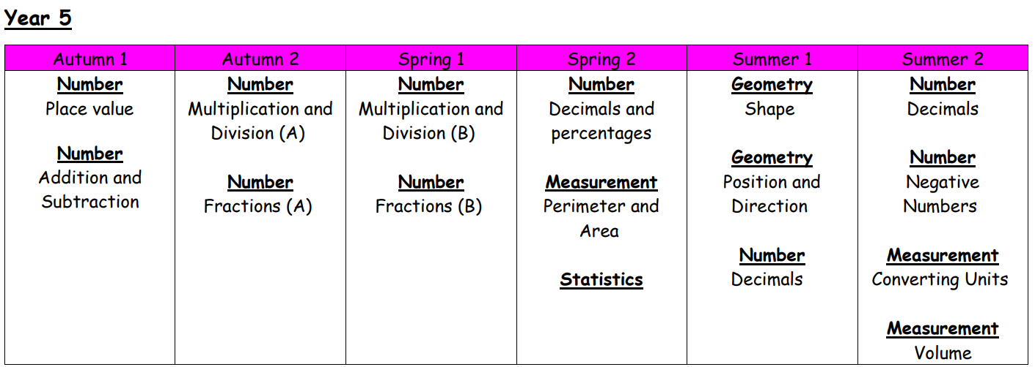
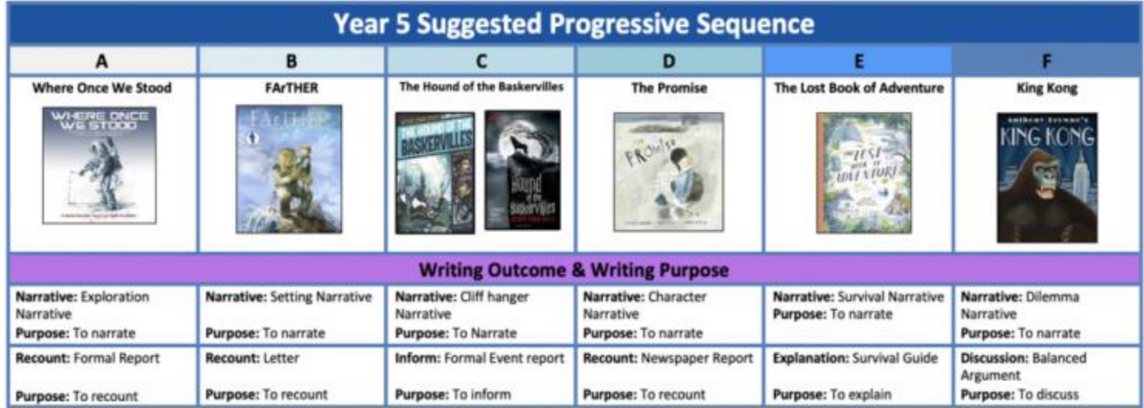

Slide 7
RE
Science
Earth, Sun and Moon
Forces
Properties, changes and separating materials
Life Cycles
Studying Living things

Slide 8
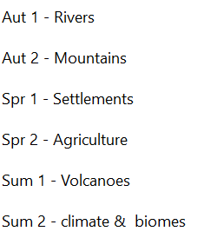
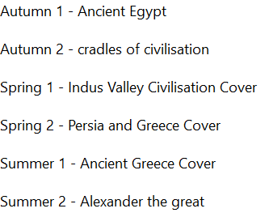
Geography
History

Slide 9

Attendance and punctuality
Attendance at school is very important, as research shows that children who have regular attendance (97% or more) develop more positive mental health, well-being, relationships with their peers are achieve better in school.
This is a trend that we also see for the pupils in our school.
Punctuality – Please ensure your child arrives at the start of the school day at 8.50am, as this is when our children’s learning starts. Children arriving after 9.00am have to enter school through the school office and will be given a late mark.
If a child arrives at 9.00am three times a week they end up missing over 3 days of learning by the end of the school year.

Slide 10

Absent from education…
Attendance has long term impacts on a child’s life chances, including attainment, employment prospects and future earnings. Every professional that interacts with a child or young person of school age, or their family, has a role to play to help them to attend school regularly.
Research highlights children being absent from education for prolonged periods and/or on repeat occasions can act as a vital warning sign to a range of safeguarding issues including neglect, child sexual and child criminal exploitation - particularly county lines.
Number of PA'S academic year 24/25 = 10 children = 5.6%
Number of severely PA'S academic year 24/25 = 0 children = 0%
Notes:
ADD your settings figures to this slide for PA’s and severely PA’s.
Discuss what a PA and sever PA is. Share data for your setting.
Discuss the settings approach to improving attendance.
Explain this is a national, local and setting focus as the links to being absent from education and then being at risk of other safeguarding issues is evident in data and research e.g. exploitation.

Slide 11
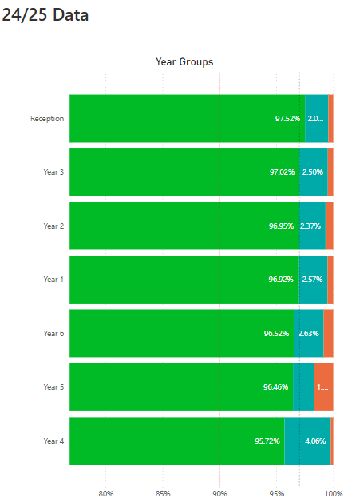
Impact of Attendance and Punctuality
Within each of our classes we have seen that where attendance is positive then this tends to result in more positive mental health, well-being and outcomes for these children.

Slide 12
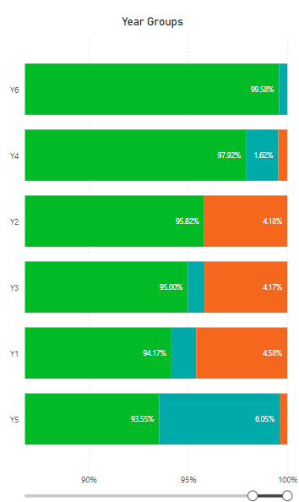
Current School of Attendance
How has your child’s year group started the school year?
The Primary National Attendance is currently 94.75%

Slide 13
How do we reward our children’s positive Attendance?
Weekly Whole School 100% Attendance Wheel – Child gets a prize from school.
Star in the Jar – Every day a class has 100% they earn a star for their jar. 10 Stars in the Jar = Class Reward afternoon.
£5 attendance award for the class with the highest attendance.
Weekly Popcorn award for the class with the highest attendance.
100% Attendance Certificates
97% + Attendance Raffle for the whole school year. Winning prize = £100 Amazon Voucher.

Slide 14

Reading Matters
As you’ve seen from the Topic Overview, Reading is central to the school and year group curriculum. Each half term, the children will be exposed to multiple high quality texts, chosen so that they tie into or complement learning.
These will include:
A ‘Vehicle text’ in English to inspire writing
A Reading for Pleasure text that we will read as a class (normally at the end of the day) to inspire fantastic reading attitudes and, quite often, to support learning across the curriculum
In Topic work, Science, RE, Art and DT, the children will also read other texts to consolidate and move on learning.

Slide 15

Reading at home
It’s vitally important for the children to read at home at least five times per week
The children’s reading record should be signed by an adult whenever they have read and comments can be made by the adult if they wish.
Reading books and records must be brought in every day. If your child has read, they should show a member of Year 5 staff and we will monitor how often reading is happening.
Reading books can be change any day of the week.
We will be introducing various Reading Challenges over the year to help support a love for Reading.

Slide 16

Reading at home (cont…)
Children will read every day in school in either, their Guided Reading session, English lessons or in foundation subject lessons.
The skills of reading and understanding will be taught in Guided Reading lessons.
Reading records will be monitored closely to ensure the children are practising at home. Where this is not the case, school will contact families to offer support in this.
Reading Rewards – When a child has their reading record signed 5 times in one week, they will receive a raffle ticket and be in with a chance to be our Star Reader.

Slide 17

Our UNIQUE curriculum is rich in knowledge.
We believe that helping children to accumulate layers of knowledge allows them to make connections to new conceptual learning, building layers and layers of understanding.
For each subject studied, we produce a Knowledge Organiser that we refer to in lessons.
All information regarding each half term can be found on our school website. Please look over these documents so that you’re familiar with the content being delivered to the children.
The Wider Curriculum

Slide 18
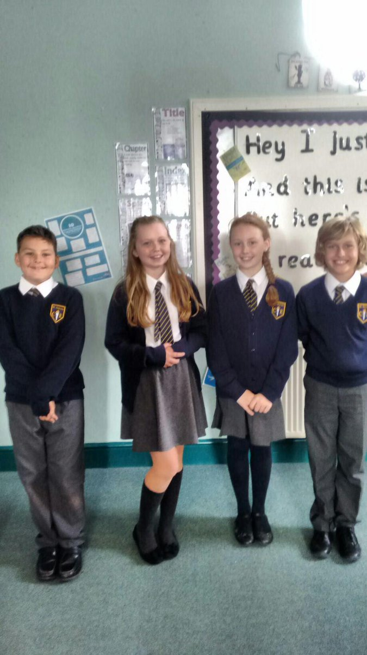
Correct uniform
White shirt or blouse, (to be tucked in at all times),
St Andrew’s tie, (top button to be done up and tie to be smartly fastened),
Grey skirt or trousers
Grey socks or grey tights ,smart black shoes (not trainers),
Navy blue v-neck school jumper with/without school badge.
Jewellery – small stud earrings only,
Watches – no smart watches
Hair – long hair (hair which rests on shoulder or longer) MUST be tied back, hair accessories MUST be small and plain and in school colours.
No nail varnish – must be removed.

Slide 19

PE timetable & Kit
PE Tuesdays
Swimming kit: trunks/full swimming costume. Swimming caps and towels.
Earrings must be taken out at home before school.
PE Kit plain navy shorts, plain white t shirt or school t-shirt, plain black trainers. We encourage the children to wear track-suits and waterproofs in the winter months. As communicated, children can wear their kit to school on PE days.
We endeavour to do all PE activities outside so a thin, waterproof jacket / training top would be useful.

Slide 20

Year 5 Homework
Reading (5 times per week and recorded in Reading Record – awaiting arrival of these).
This can be from a school reading book or from a book, magazine etc that your child has and enjoys at home.
Spelling practice daily (Statutory Spelling lists)
Knowledge Organisers on the class webpages. The children should use these to embed key facts about our curriculum areas.
TimesTable Rockstar and Numbots daily

Slide 21

We expect all children to access Times Table Rockstar weekly (x3 per week absolute minimum)
The more they play in ‘GARAGE’ mode, the more progress they will see on their heatmap each time they play. (EXPLAINED ON THE NEXT SECTION)
Your child’s heatmap is based on the speed they know each times table fact.
TTRockstars uses an algorithm to present them with facts they need to work on, based on their heatmap
Weekly year group tournaments will continue with certificates each week for the top 3 players in each class.
Tiny comes to visit – which class this week?

Slide 22
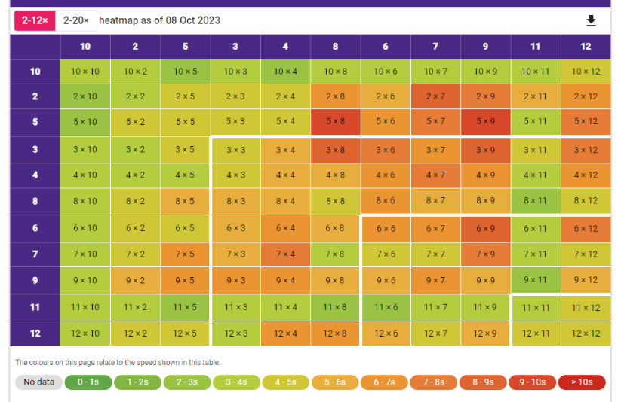
Year 5 Homework – TT Rockstars (3x per week minimum)
You can access your child’s individual heatmap at any time.
To do this:
Select GARAGE MODE
SCROLL DOWN – here you will see their heatmap. This changes each time they play. Therefore, your child can see their individual progress after each Garage session – this will be a great incentive!
The more green the better!

Slide 23


Slide 24
myHappyMind
myHappymind is an NHS-backed curriculum in primary schools, secondary schools, and nurseries and is focused on building resilience, self-esteem, and happiness in children.
•An award-winning programme that has received national recognition for its exceptional work in schools, nurseries, families, and organisations across the UK.
•Backed by NHS using preventative strategies firmly rooted in science, research, and the fields of neuroscience and positive psychology.

Slide 25

myHappyMind
Philosophy
Proactive not reactive – helping our children to understand themselves and build self esteem before becoming reactive to challenging situations.
Stigma Reversing – when people get the ‘why’ they take action. Understanding science behind our brains.
A systematic approach – a child centred program that includes families and school through the myHappyMind app.
Fun and easy to teach – interactive lessons which are enjoyable for all.
Equal for all – supporting our most vulnerable children.
Your authentication code is 145453

Slide 26

School Trips & Blended Knowledge & Experience
Myn-y-Don – Building Resilience, Communication and OAA
(April 2026)
RE Trips– places of worship (Synagogue and Church)
As our Residential is costly, we will try to limit the cost of educational visits

Slide 27
Assessment
The children will be assessed regularly by their class teacher, as part of our formative assessment cycle
This will help teachers to inform planning and know what each child needs to do / know to progress further
This style of assessment takes place in all subject areas
Summative Tests
Each term, the children will complete a range of summative assessments – NFER papers. Their assessments will be discussed in a conversation at parents’ evenings. Test weeks will be near the end of Autumn 2, Spring 2 and Summer 2 half terms.
ATTENDANCE IS CRUCIAL!

Slide 28

Emails via
communication.standrews@ldst.org.uk

