Slide 1


Meet the Teacher
September 2025
Welcome to Year 4

Slide 2

Attendance and punctuality
Attendance at school is very important, as research shows that children who have regular attendance (97% or more) develop more positive mental health, well-being, relationships with their peers are achieve better in school.
This is a trend that we also see for the pupils in our school.
Punctuality – Please ensure your child arrives at the start of the school day at 8.50am, as this is when our children’s learning starts. Children arriving after 9.00am have to enter school through the school office and will be given a late mark.
If a child arrives at 9.00am three times a week they end up missing over 3 days of learning by the end of the school year.

Slide 3

Absent from education…
Attendance has long term impacts on a child’s life chances, including attainment, employment prospects and future earnings. Every professional that interacts with a child or young person of school age, or their family, has a role to play to help them to attend school regularly.
Research highlights children being absent from education for prolonged periods and/or on repeat occasions can act as a vital warning sign to a range of safeguarding issues including neglect, child sexual and child criminal exploitation - particularly county lines.
Number of PA'S academic year 24/25 = 10 children = 5.6%
Number of severely PA'S academic year 24/25 = 0 children = 0%
Notes:
ADD your settings figures to this slide for PA’s and severely PA’s.
Discuss what a PA and sever PA is. Share data for your setting.
Discuss the settings approach to improving attendance.
Explain this is a national, local and setting focus as the links to being absent from education and then being at risk of other safeguarding issues is evident in data and research e.g. exploitation.

Slide 4
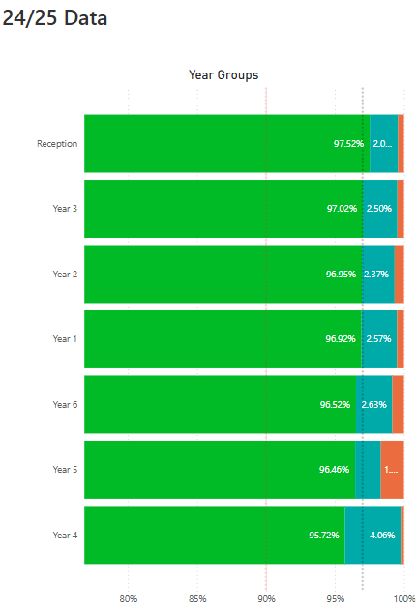
Impact of Attendance and Punctuality
Within each of our classes we have seen that where attendance is positive then this tends to result in more positive mental health, well-being and outcomes for these children.

Slide 5
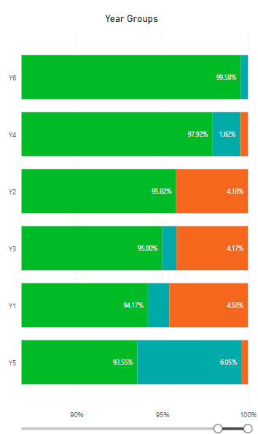
Current School of Attendance
How has your child’s year group started the school year?
The Primary National Attendance is currently 94.75%

Slide 6
How do we reward our children’s positive Attendance?
Weekly Whole School 100% Attendance Wheel – Child gets a prize from school.
Star in the Jar – Every day a class has 100% they earn a star for their jar. 10 Stars in the Jar = Class Reward afternoon.
£5 attendance award for the class with the highest attendance.
Weekly Popcorn award for the class with the highest attendance.
100% Attendance Certificates
97% + Attendance Raffle for the whole school year. Winning prize = £100 Amazon Voucher.

Slide 7
Staff
Teacher – Miss Barton
Teaching Assistants – Mrs Calleja
PPA Cover – Miss Lowson & Mr Burrus
(Monday afternoons)
Our PE days are Mondays and Fridays

Slide 8
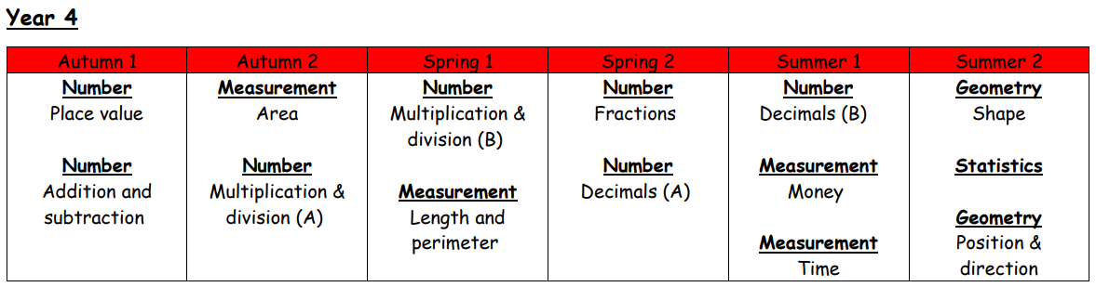
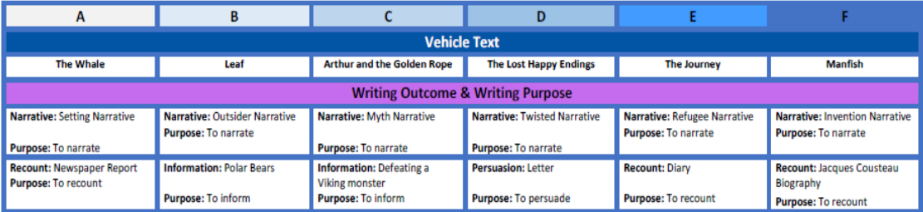

Slide 9


History & Geography overview
Geography
History

Slide 10
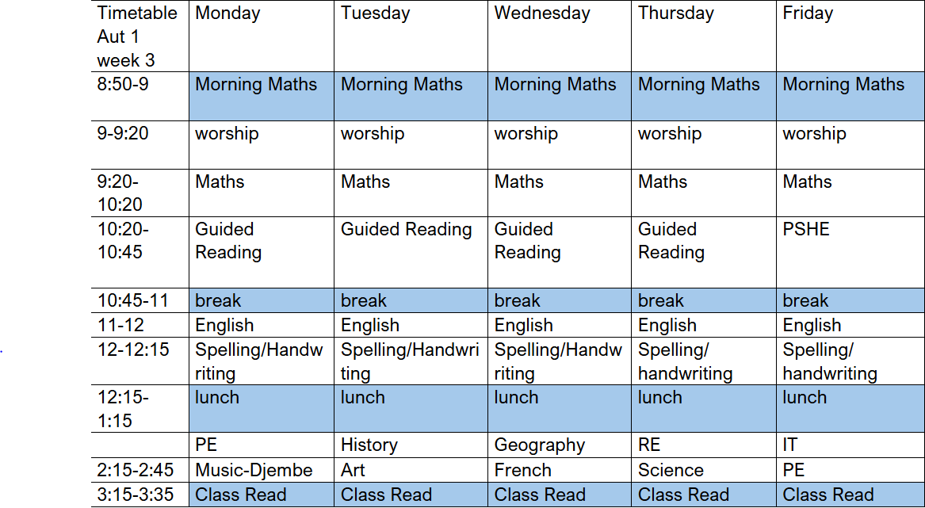
What the children learn when

Slide 11
Reading Matters
As you’ve seen from the Topic Overview, Reading is central to the school and year group curriculum. Each half term, the children will be exposed to a range of high quality texts, chosen so that they tie into, or complement, learning.
These will include:
A ‘Vehicle text’ in English to inspire writing
A series of whole class guided reading texts linked to writing, foundation subjects, RE or science. Children will read aloud once a week in class during guided reading.
A Reading for Pleasure text that we will read as a class (normally at the end of the day) to inspire fantastic reading attitudes
Reading during Picture News class worship when they are worship leaders for the half term
In Topic work, Science, RE, Art and DT, the children will also read other texts to consolidate and move on learning.

Slide 12
Reading at home
It’s vitally important for the children to read at home at least five times per week for approximately 10-15 mins.
Younger children should read to an adult, whilst older children can read to themselves as long as what they have read is discussed with an adult at some point over the course of the week.
The children’s reading record should be signed by an adult whenever they have read and comments can be made by the adult if they wish.
Reading books and records must be brought in every day so that opportunities can be maximised to read and progress in school too. They will be checked over the week by an adult at school.

Slide 13
https://primarysite-prod-sorted.s3.amazonaws.com/standrews/UploadedDocument/6980d3da-ca99-4fe5-83a1-70c75f6e20da/st-andrews-reading-at-home-support.pdf
On our school website, there are documents that we have designed to support strategies for Reading at Home.
It has suggested questions you could ask the children about their book that closely follow the questioning techniques that we use in school.
Click the link above

Slide 14
myHappyMind
myHappymind is an NHS-backed curriculum in primary schools, secondary schools, and nurseries and is focused on building resilience, self-esteem, and happiness in children.
•An award-winning programme that has received national recognition for its exceptional work in schools, nurseries, families, and organisations across the UK.
•Backed by NHS using preventative strategies firmly rooted in science, research, and the fields of neuroscience and positive psychology.

Slide 15

myHappyMind
Philosophy
Proactive not reactive – helping our children to understand themselves and build self esteem before becoming reactive to challenging situations.
Stigma Reversing – when people get the ‘why’ they take action. Understanding science behind our brains.
A systematic approach – a child centred program that includes families and school through the myHappyMind app.
Fun and easy to teach – interactive lessons which are enjoyable for all.
Equal for all – supporting our most vulnerable children.
Your authentication code is 145453

Slide 16
Correct uniform
White shirt or blouse, (to be tucked in at all times), St Andrew’s tie, (top button to be done up and tie to be smartly fastened), grey skirt or trousers, girl’s knee length white or grey socks or grey tights ,smart black shoes (not trainers), blue school jumper with school badge or navy blue jumper in same colour as school badge jumper.
Jewellery – small stud earrings only, watch – no other jewellery (including rings)
Hair – long hair (hair which rests on shoulder or longer) MUST be tied back, hair accessories MUST be small and plain and in school colours.
No nail varnish – children wearing nail varnish will be sent to office to remove it.

Slide 17
PE/Swimming timetable
PE Monday afternoon and Friday afternoon
Earrings must be taken out by child and looked after. If child cannot take out earrings they should be taken out at home for the whole of that day.
Swimming Y4 in Autumn 2
Girls swimsuit (not bikini), swim hat
Boys swimming trunks (not shorts), swim hat
PE Kit plain navy shorts, plain white t shirt or school t-shirt, black pumps / trainers. We encourage the children to wear track-suits and waterproofs in the winter months. As communicated, children can wear their kit to school on PE days.

Slide 18


Slide 19
Year 4 Homework
Reading every evening
For all subjects, we have uploaded Knowledge Organisers to the class webpages. The children could use these to embed key facts about our curriculum areas.

Slide 20
Year 4 Homework
Purple Mash – lots of games and extra learning points
Times Table Rockstars & Numbots – practising times tables is vital

Slide 21

We expect all children to access Times Table Rockstar weekly (x3 per week absolute minimum)
The more they play in ‘GARAGE’ mode, the more progress they will see on their heatmap each time they play. (EXPLAINED ON THE NEXT SECTION)
Your child’s heatmap is based on the speed they know each times table fact.
TTRockstars uses an algorithm to present them with facts they need to work on, based on their heatmap
Weekly year group tournaments will continue with certificates each week for the top 3 players in each class.

Slide 22
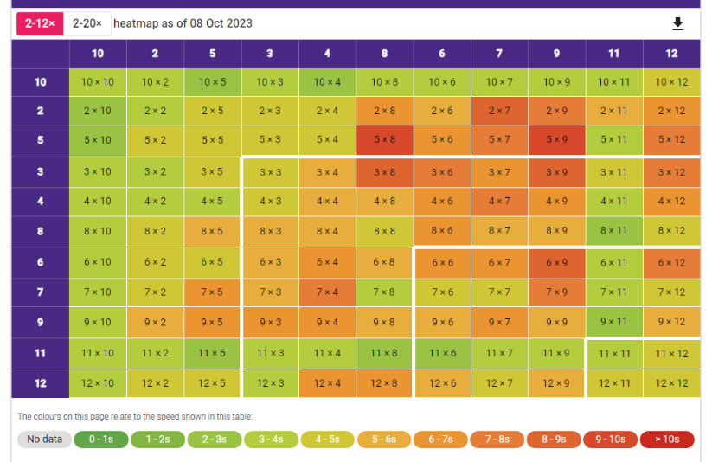
TT Rockstars (3x per week minimum)
You can access your child’s individual heatmap at any time.
To do this:
Select GARAGE MODE
SCROLL DOWN – here you will see their heatmap. This changes each time they play. Therefore, your child can see their individual progress after each Garage session – this will be a great incentive!
The more green the better!

Slide 23
TTRS Stats:
21. That’s the magic number.
21 minutes per week during year 4, is the typical amount of TTRS practice put in by those scoring 25/25.

Slide 24
School Trips
Camp Day (at school)
Visit to Hindu temple (RE – what does it mean to be a Hindu in Britain today?)

Slide 25
Assessment
The children will be assessed regularly by their class teacher, as part of our formative assessment cycle
This will help teachers to inform planning and know what each child needs to do / know to progress further
This style of assessment takes place in all subject areas
Multiplication Times Tables Check
https://www.gov.uk/government/publications/multiplication-tables-check-information-for-parents/multiplication-tables-check-information-for-parents-text-version--2
June 2025

Slide 26
Website and Twitter
Half Termly Document Links

Slide 27
Any Questions?
If you have any questions at all, then please contact your child’s class teacher:
communication.standrews@ldst.org.uk

