Slide 1

Meet the Teacher
Year 1
September 2025

Slide 2


Together in God’s love, we learn, inspire and grow

Slide 3
Year 1 teachers
Mrs Stalker
Mr Taylor

Slide 4

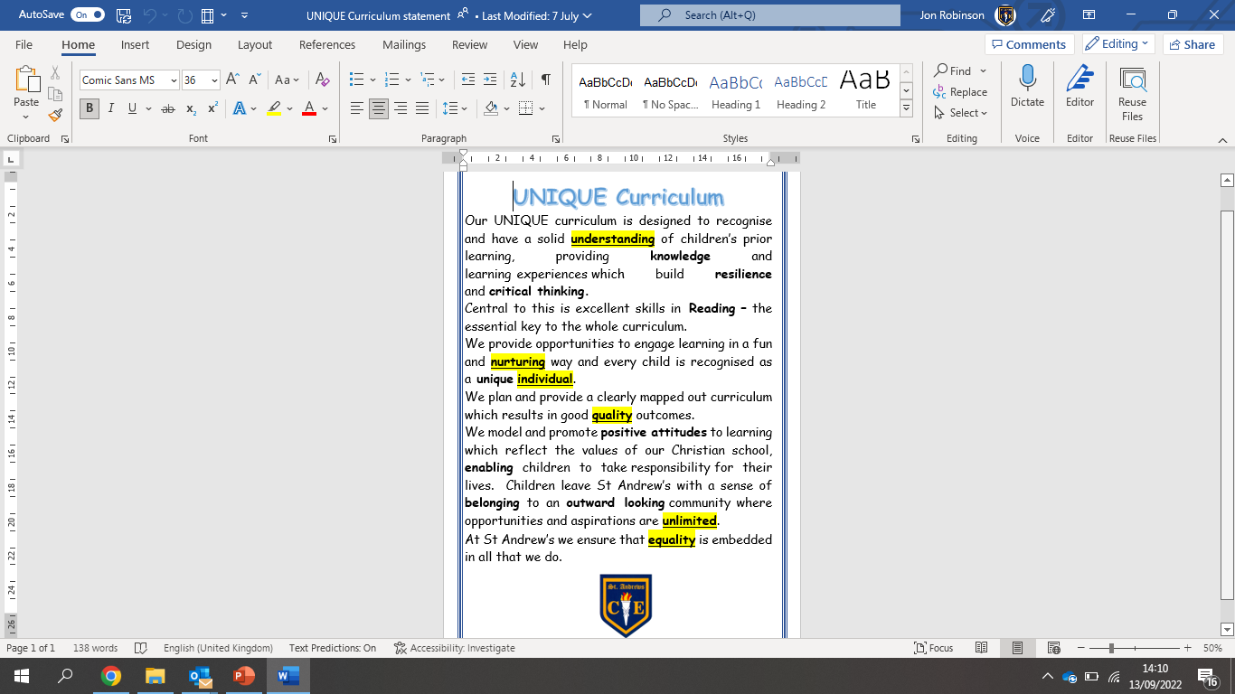
Our UNIQUE Curriculum

Slide 5

A typical day in Year 1
9-9.15am Collective Worship
9.15-10am Read Write Inc
10-10.45am English
Playtime (10.45-11am)
11am-12pm Maths
Lunchtime (12-12.45pm)
12.45 – 1.45pm Foundation Lesson
Playtime (1.45-2pm)
2-3pm Foundation Lesson
3pm Story time

Slide 6
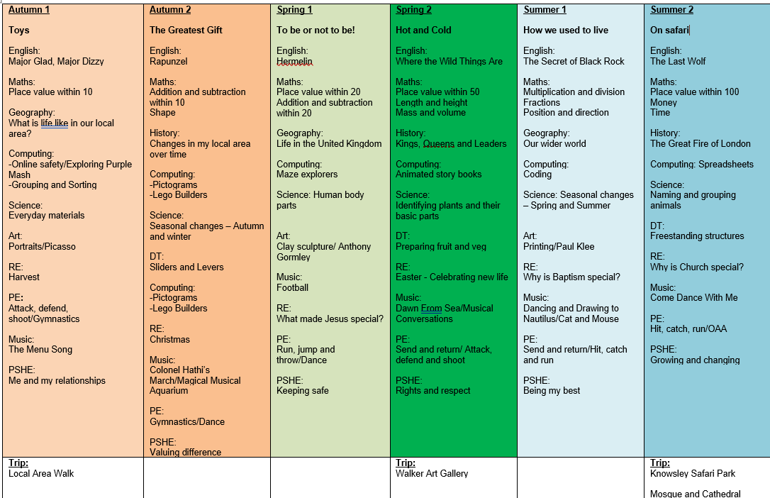
Year 1 Topic Overview

Slide 7

Phonics
Phonics is taught through Read Write Inc sessions. The children are assessed every half term and groups are rearranged accordingly.
Phonics check – children will be well prepared for this throughout the Year. Mrs Dwan is our administrator for the check. It will take place in June, just after the half term break. (Week beginning Monday 8th June)

Slide 8

Reading Matters
As you’ve seen from the Topic Overview, Reading is central to the school and year group curriculum. Each half term, the children will be exposed to multiple high quality texts, chosen so that they tie into or complement learning.
These will include:
A ‘Vehicle text’ in English to inspire writing
A Reading for Pleasure text that we will read as a class (normally at the end of the day) to inspire fantastic reading attitudes
In Topic work, Science, RE, Art and DT, the children will also read other texts to consolidate and move on learning.
Children will read every day in school in either their guided reading session or in their RWI session.

Slide 9

Reading at home
It’s vitally important for the children to read at home
The children’s reading record should be signed by an adult whenever they have read and comments can be made by the adult if they wish.
Reading books must be in on a Friday so that the children can receive the new books from their group.
https://primarysite-prod-sorted.s3.amazonaws.com/standrews/UploadedDocument/ac8c83fe75de4721993415b3a38ccba8/reading-at-home-strategies-and-ideas-for-families.pdf
On our school website, there are documents that we have designed to support strategies for Reading at home.
It has suggested questions you could ask the children about their book that follow the questioning techniques that we use in school.

Slide 10

PE timetable
PE is on Wednesday and Friday.
Earrings must be taken out at home before school or covered with plasters.
PE Kit plain navy shorts, plain white t shirt or school t-shirt, trainers. We encourage the children to wear track-suits in the winter months. Children should wear their kit to school on PE days.

Slide 11


Homework
Reading (QR codes)
Numbots
Knowledge Organisers to the class webpage
Purple Mash

Slide 12

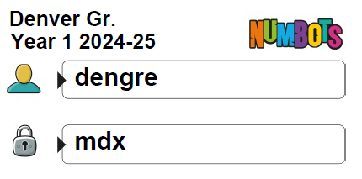
We expect your child to access ‘Numbots’ weekly to support with their fluency within maths and improve their number sense.
This year, a sticker reward system will be used for those who successfully complete each stage.
Children should be encouraged to work independently at home (as they will at school) when accessing to ensure the content is appropriate for them.

Slide 13


Slide 14
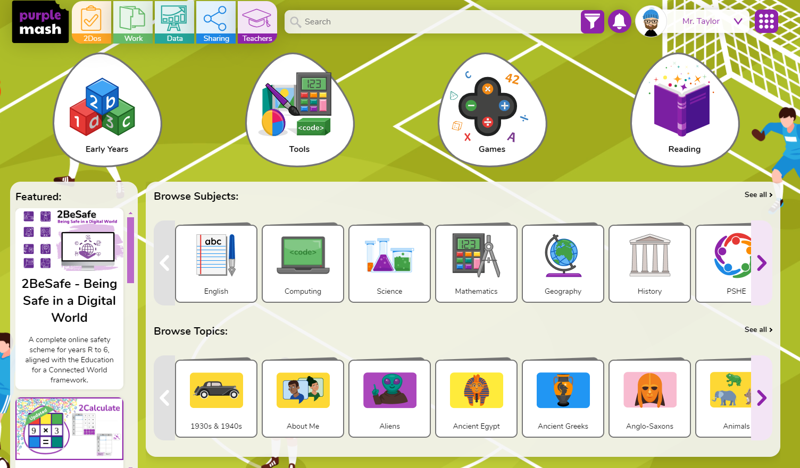

Slide 15
myHappyMind
myHappymind is an NHS-backed curriculum in primary schools, secondary schools, and nurseries and is focused on building resilience, self-esteem, and happiness in children.
•An award-winning programme that has received national recognition for its exceptional work in schools, nurseries, families, and organisations across the UK.
•Backed by NHS using preventative strategies firmly rooted in science, research, and the fields of neuroscience and positive psychology.

Slide 16

myHappyMind
Philosophy
Proactive not reactive – helping our children to understand themselves and build self esteem before becoming reactive to challenging situations.
Stigma Reversing – when people get the ‘why’ they take action. Understanding science behind our brains.
A systematic approach – a child centred program that includes families and school through the myHappyMind app.
Fun and easy to teach – interactive lessons which are enjoyable for all.
Equal for all – supporting our most vulnerable children.
Your authentication code is 145453

Slide 17
Assessment
The children will be assessed regularly by their class teacher, as part of our formative assessment cycle
This will help teachers to inform planning and know what each child needs to do / know to progress further
This style of assessment takes place in all subject areas
Summative Tests
In Spring and Summer, the children will complete a range of summative assessments – NFER papers. Their assessments will be reported home and will be a conversation at parents’ evenings.

Slide 18

Attendance and punctuality
Attendance at school is very important, as research shows that children who have regular attendance (97% or more) develop more positive mental health, well-being, relationships with their peers are achieve better in school.
This is a trend that we also see for the pupils in our school.
Punctuality – Please ensure your child arrives at the start of the school day at 8.50am, as this is when our children’s learning starts. Children arriving after 9.00am have to enter school through the school office and will be given a late mark.
If a child arrives at 9.00am three times a week they end up missing over 3 days of learning by the end of the school year.

Slide 19

Absent from education…
Attendance has long term impacts on a child’s life chances, including attainment, employment prospects and future earnings. Every professional that interacts with a child or young person of school age, or their family, has a role to play to help them to attend school regularly.
Research highlights children being absent from education for prolonged periods and/or on repeat occasions can act as a vital warning sign to a range of safeguarding issues including neglect, child sexual and child criminal exploitation - particularly county lines.
Number of PA'S academic year 24/25 = 10 children = 5.6%
Number of severely PA'S academic year 24/25 = 0 children = 0%
Notes:
ADD your settings figures to this slide for PA’s and severely PA’s.
Discuss what a PA and sever PA is. Share data for your setting.
Discuss the settings approach to improving attendance.
Explain this is a national, local and setting focus as the links to being absent from education and then being at risk of other safeguarding issues is evident in data and research e.g. exploitation.

Slide 20
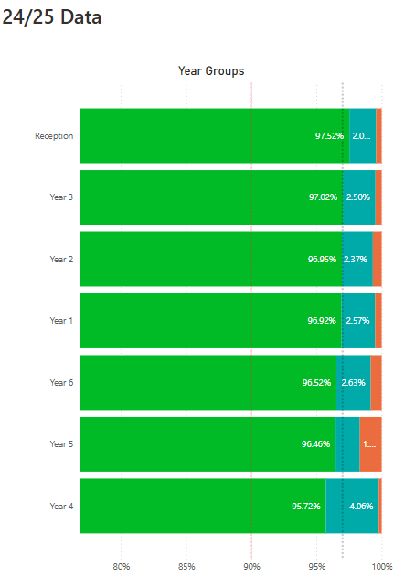
Impact of Attendance and Punctuality
Within each of our classes we have seen that where attendance is positive then this tends to result in more positive mental health, well-being and outcomes for these children.

Slide 21
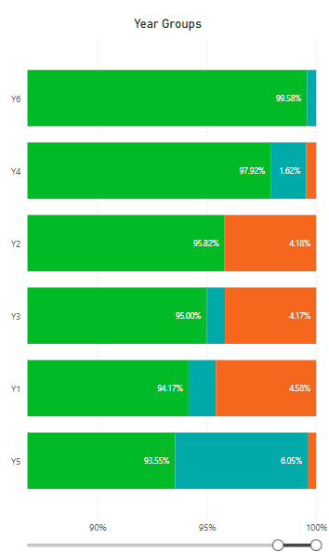
Current School of Attendance
How has your child’s year group started the school year?
The Primary National Attendance is currently 94.75%

Slide 22
How do we reward our children’s positive Attendance?
Weekly Whole School 100% Attendance Wheel – Child gets a prize from school.
Star in the Jar – Every day a class has 100% they earn a star for their jar. 10 Stars in the Jar = Class Reward afternoon.
£5 attendance award for the class with the highest attendance.
Weekly Popcorn award for the class with the highest attendance.
100% Attendance Certificates
97% + Attendance Raffle for the whole school year. Winning prize = £100 Amazon Voucher.

Slide 23


Snacks and drinks
Snacks should only be:-
Fruit, fresh or dried
Cereal bars
Children should only have water in their school bottles.
If your child can not use the school bottles and/or does not drink water, please speak to the class teacher.

Slide 24
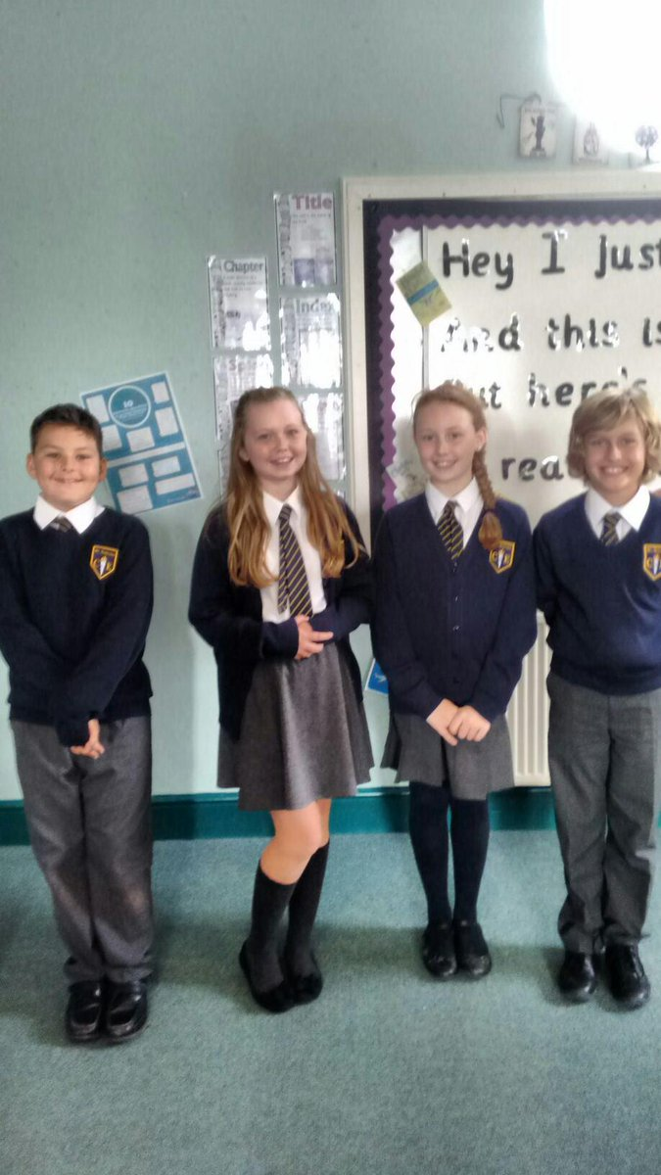
Correct uniform
White shirt or blouse, (to be tucked in at all times),
St Andrew’s tie, (top button to be done up and tie to be smartly fastened),
Grey skirt or trousers
Grey socks or grey tights ,smart black shoes (not trainers),
Navy blue v-neck school jumper with/without school badge.
Jewellery – small stud earrings only,
Watches – no smart watches
Hair – long hair (hair which rests on shoulder or longer) MUST be tied back, hair accessories MUST be small and plain and in school colours.
No nail varnish – must be removed.

Slide 25

If you have any questions at all, then please contact me at:
Communication.standrews@ldst.org.uk

