Slide 1

Meet the Teacher
September 2025

Slide 2
Staff
Miss Jones
Mrs Dwan
Mrs Shannon

Slide 3

Our UNIQUE Curriculum

Slide 4
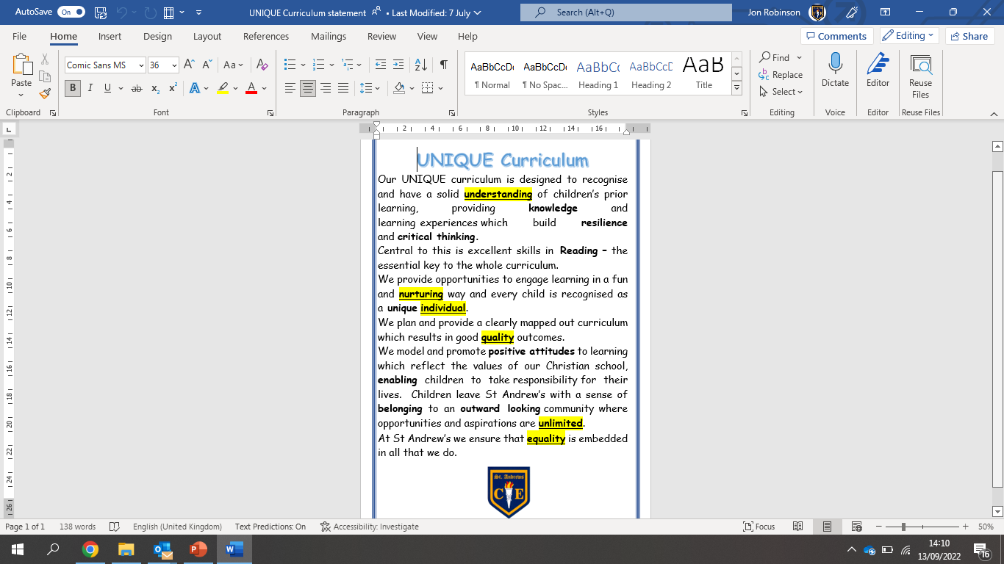

Slide 5
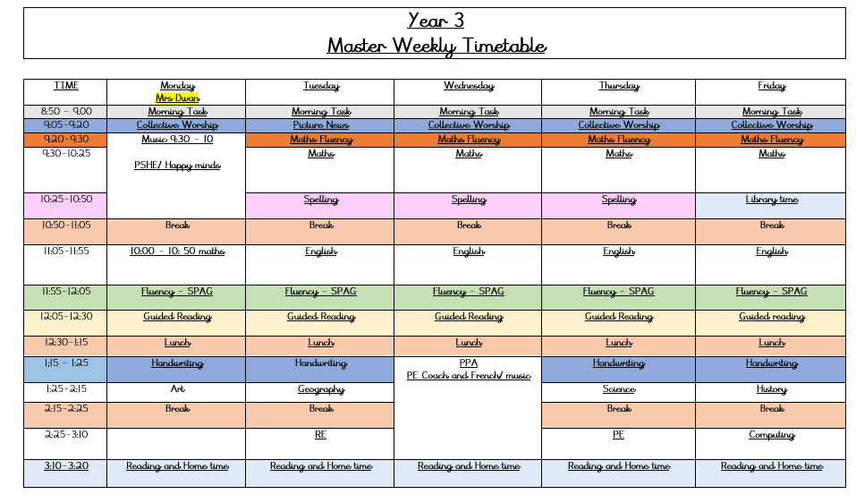
What the children will learn when

Slide 6
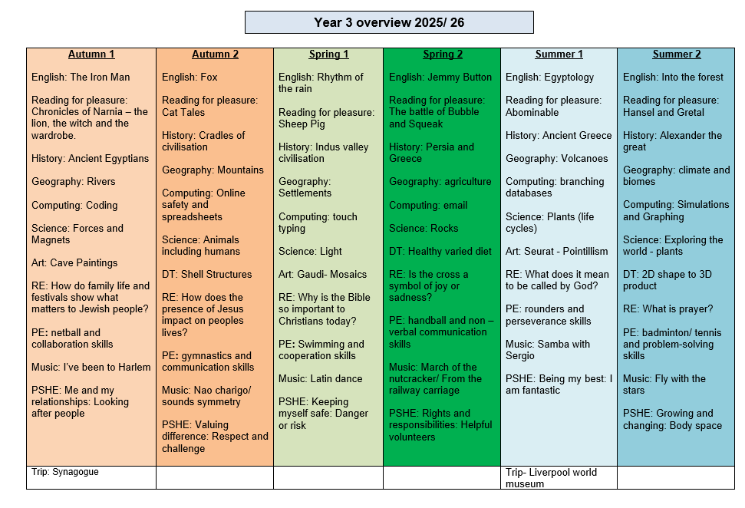

Slide 7

Homework Expectations
Reading – daily
Times Table Rockstar
We have uploaded Knowledge Organisers to the class webpages. The children should use these to embed key facts about our curriculum areas.

Slide 8

Reading Matters
Reading is central to the school and year group curriculum. Each half term, the children will be exposed to multiple high-quality texts, chosen so that they tie into or complement learning.
These will include:
A ‘Vehicle text’ in English to inspire writing
A Reading for Pleasure text that we will read as a class (normally at the end of the day) to inspire fantastic reading attitudes
In Topic work, History , Geography, Science, RE, Art and DT, the children will also read other texts to consolidate and move on learning.

Slide 9

Reading at home
It’s vitally important for the children to read at home at least five times per week
The children’s reading record should be signed by an adult whenever they have read, and comments can be made by the adult if they wish.
Reading books and records must be brought in every day. If your child has read, they should show a member of Year 3 staff, and we will monitor how often reading is happening.
When completing a book, your child will take a short on-line quiz in school. They will gain points from this to add to a leader board. This helps staff to track good reading habits and comprehension.
Reading will be assessed daily with summative reading tests taken on-line once per term.

Slide 10

Reading at home (cont…)
Children will read every day in school in their guided reading session.
Reading records will be monitored closely to ensure the children are practising at home. Where this is not the case, school will contact families to offer support in this.
Reading Rewards – When a child has their reading record signed 5 times in one week, they will receive a raffle ticket and be in with a chance to be our Star Reader.

Slide 11

We expect all children to access Times Table Rockstar weekly (x3 per week minimum)
Each Friday, your child will bring home a ‘heatmap’ which outlines their knowledge and speed of times table facts. The more they play in ‘GARAGE’ mode, the more progress they will see on their heatmap each week.
We expect you to work with your child to learn the times table facts they need focus on. Your child’s heatmap is based on the speed they know each times table fact.
TTRockstar uses an algorithm to present them with facts they need to work on, based on their heatmap
Weekly year group tournaments will continue with certificates each week for the top 3 players in each class.

Slide 12
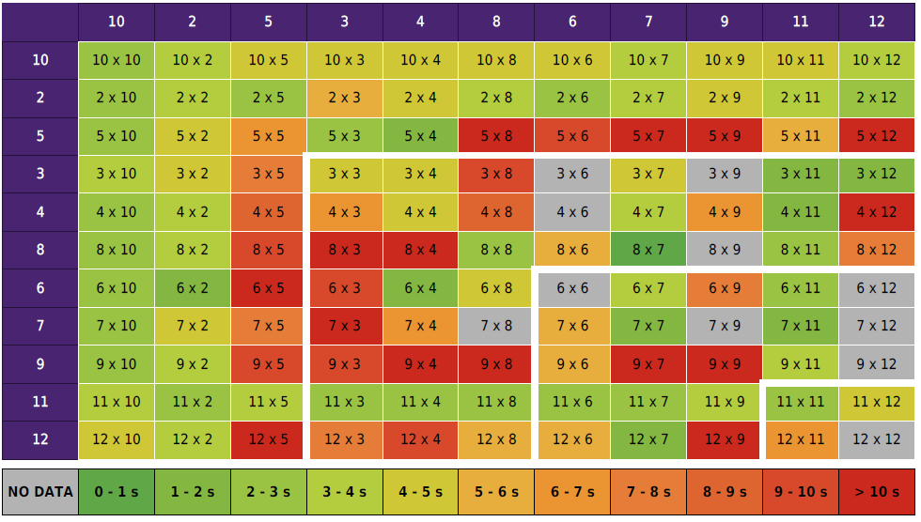
Example Heatmap

Slide 13
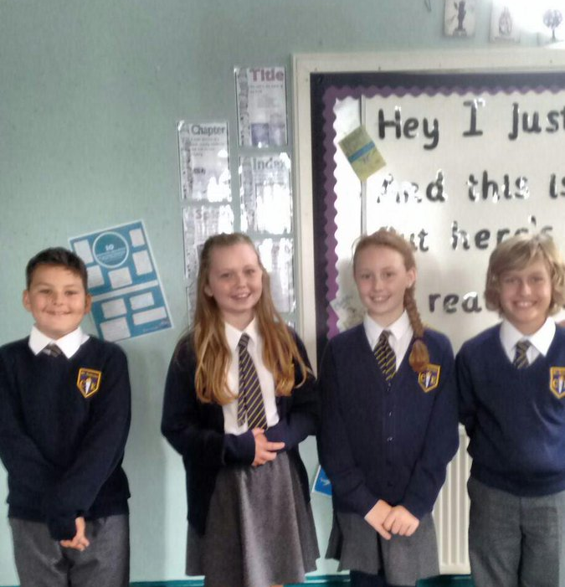
Correct uniform
White shirt or blouse, (to be tucked in at all times),
St Andrew’s tie, (top button to be done up and tie to be smartly fastened),
Grey skirt or trousers, girl’s knee length
White or grey socks or grey tights ,smart black shoes (not trainers),
Blue school jumper with school badge or navy-blue jumper in same colour as school badge jumper.
Jewellery – small stud earrings only, watch – no other jewellery (including rings)
Hair – long hair (hair which rests on shoulder or longer) MUST be tied back, hair accessories MUST be small and plain and in school colours.
No nail varnish – children wearing nail varnish will be sent to office to remove it.

Slide 14

Attendance and punctuality
Attendance at school is very important, as research shows that children who have regular attendance (97% or more) develop more positive mental health, well-being, relationships with their peers are achieve better in school.
This is a trend that we also see for the pupils in our school.
Punctuality – Please ensure your child arrives at the start of the school day at 8.50am, as this is when our children’s learning starts. Children arriving after 9.00am have to enter school through the school office and will be given a late mark.
If a child arrives at 9.00am three times a week they end up missing over 3 days of learning by the end of the school year.

Slide 15

Absent from education…
Attendance has long term impacts on a child’s life chances, including attainment, employment prospects and future earnings. Every professional that interacts with a child or young person of school age, or their family, has a role to play to help them to attend school regularly.
Research highlights children being absent from education for prolonged periods and/or on repeat occasions can act as a vital warning sign to a range of safeguarding issues including neglect, child sexual and child criminal exploitation - particularly county lines.
Number of PA'S academic year 24/25 = 10 children = 5.6%
Number of severely PA'S academic year 24/25 = 0 children = 0%
Notes:
ADD your settings figures to this slide for PA’s and severely PA’s.
Discuss what a PA and sever PA is. Share data for your setting.
Discuss the settings approach to improving attendance.
Explain this is a national, local and setting focus as the links to being absent from education and then being at risk of other safeguarding issues is evident in data and research e.g. exploitation.

Slide 16
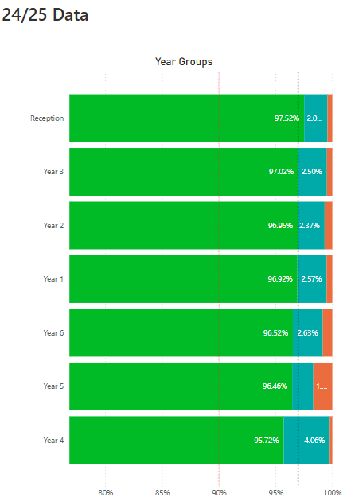
Impact of Attendance and Punctuality
Within each of our classes we have seen that where attendance is positive then this tends to result in more positive mental health, well-being and outcomes for these children.

Slide 17
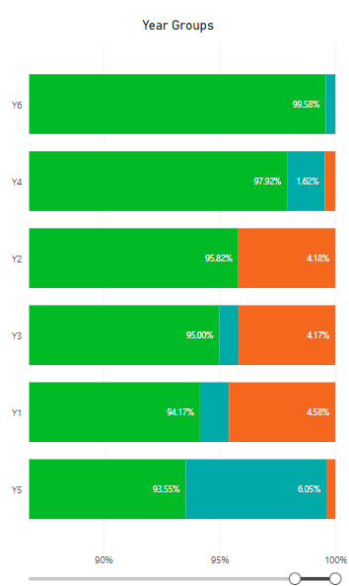
Current School of Attendance
How has your child’s year group started the school year?
The Primary National Attendance is currently 94.75%

Slide 18
How do we reward our children’s positive Attendance?
Weekly Whole School 100% Attendance Wheel – Child gets a prize from school.
Star in the Jar – Every day a class has 100% they earn a star for their jar. 10 Stars in the Jar = Class Reward afternoon.
£5 attendance award for the class with the highest attendance.
Weekly Popcorn award for the class with the highest attendance.
100% Attendance Certificates
97% + Attendance Raffle for the whole school year. Winning prize = £100 Amazon Voucher.

Slide 19

PE timetable
PE Wednesday and Thursday
PE Kit plain navy shorts, plain white t shirt or school t-shirt, trainers. We encourage the children to wear track-suits and waterproofs in the winter months. As communicated, children can wear their kit to school on PE days.
Swimming – Spring 1
Swimming kit: trunks (not swimming shorts) for boys, swimming costume (not bikini two piece) for girls, swimming cap if your child has hair longer than shirt collar, towel
Earrings must be taken out at home before school.

Slide 20


Snacks and drinks
Snacks should only be:-
Fruit, fresh or dried
Cereal bars
Children should only have water in their school bottles.
If your child can not use the school bottles and/or does not drink water, please speak to the class teacher.

Slide 21
myHappyMind
myHappymind is an NHS-backed curriculum in primary schools, secondary schools, and nurseries and is focused on building resilience, self-esteem, and happiness in children.
•An award-winning programme that has received national recognition for its exceptional work in schools, nurseries, families, and organisations across the UK.
•Backed by NHS using preventative strategies firmly rooted in science, research, and the fields of neuroscience and positive psychology.

Slide 22

myHappyMind
Philosophy
Proactive not reactive – helping our children to understand themselves and build self esteem before becoming reactive to challenging situations.
Stigma Reversing – when people get the ‘why’ they take action. Understanding science behind our brains.
A systematic approach – a child centred program that includes families and school through the myHappyMind app.
Fun and easy to teach – interactive lessons which are enjoyable for all.
Equal for all – supporting our most vulnerable children.
Your authentication code is 145453

Slide 23

School Trips
Visit to the synagogue-THIS HALF TERM!
Liverpool Museum – SUMMER 1.

Slide 24
Assessment
The children will be assessed regularly by their class teacher, as part of our formative assessment cycle
This will help teachers to inform planning and know what each child needs to do / know to progress further
This style of assessment takes place in all subject areas
Summative Tests
-Each term, the children will complete a range of summative assessments (NFER papers) in Maths, Reading & GPS (Grammar, Punctuation and Spelling)
–Test weeks will be near the end of Autumn 2, Spring 2 and Summer 2 half terms.

Slide 25

If you have any questions at all, then please contact me through the school office:

